Slide 1
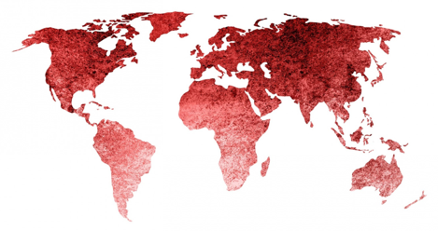
Multi-Stakeholder Workshop on the United Nations Convention against Corruption and its Review Mechanism
Saly, Senegal
8-11 May 2018
Mirella Dummar Frahi
Civil Society Team Leader, UNODC

Slide 2
CIVIL SOCIETY PARTICIPATION IN THE UNCAC
The UN Convention Against Corruption is the only universally legally-binding anti-corruption instrument in place. It entered into force in 2005 and currently has 184 parties.
The fight against corruption is a collective responsibility involving Member States as leaders, in addition to other stakeholders such as Civil Society Organizations (CSOs) and the Private Sector.
In fighting corruption, CSOs provide the checks and balances, thus improving accountability in the public and private sector.
Article 13 recognizes and provides a role for civil society in combating corruption, by calling on governments to increase transparency and participation in the decision-making process while improving public access to information.

Slide 3
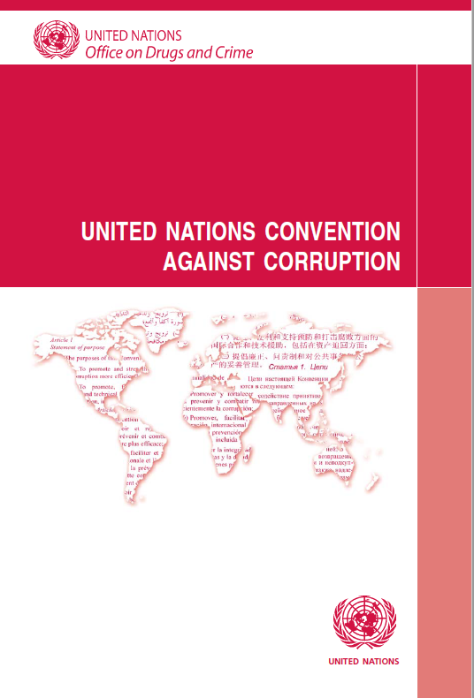
The Uncac review mechanism – how it works
The UNCAC review mechanism was adopted in 2009 at COSP3 in Doha
The review process comprises two five-year cycles
1st cycle (2010–2015): Chapter III on Criminalisation and Law Enforcement and Chapter IV on International Cooperation.
2nd cycle (2016–2021): Chapter II on Preventive Measures and Chapter V on asset recovery.
Implementation Review Group
Drawing of lots to select States Parties participating in
the review process in selected year.
Appointment by Reviewed country of focal point to
coordinate State review.

Slide 4
Stages and entry points
Phase I: Self-assessment by the country reviewed.
Countries are encouraged to consult with CS in preparing for responses; CS should remind their governments.
Phase II: Peer review.
A dialogue between the country under review and the reviewing team, conducted by two countries which are decided by random and tasked with providing experts to form a review team.
Phase III: Country review reports.
The full report is only published on the UNODC website if the reviewed country agrees. The executive summary is automatically published on the UNODC website.
Phase IV: Follow up.
Currently there is no follow-up process even though it is foreseen in the ToR for the review mechanism. However, selected countries took individualized initiatives (National strategy, Plan of action).
When can a cso get involved?
Self-assessment (input and publishing)
Country visit or in case of direct dialogue, provide CSO input
Publication of the executive summary or entire report
Follow-up to the review

Slide 5
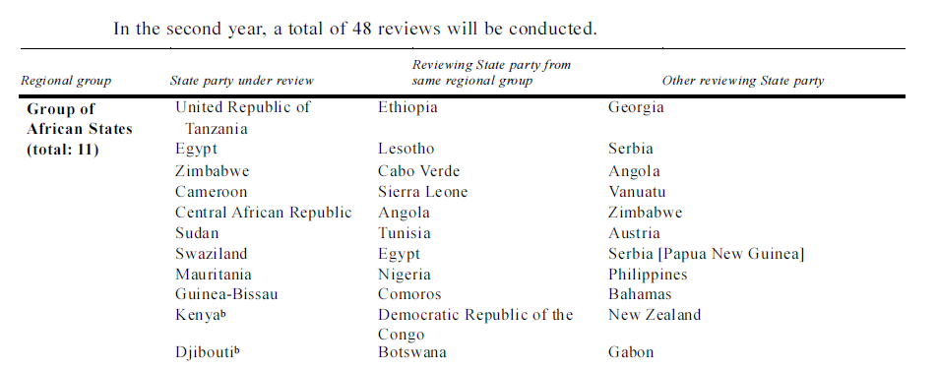
COUNTRY REVIEW STATUS
Country pairings for the second cycle of the Implementation Review Mechanism

Slide 6
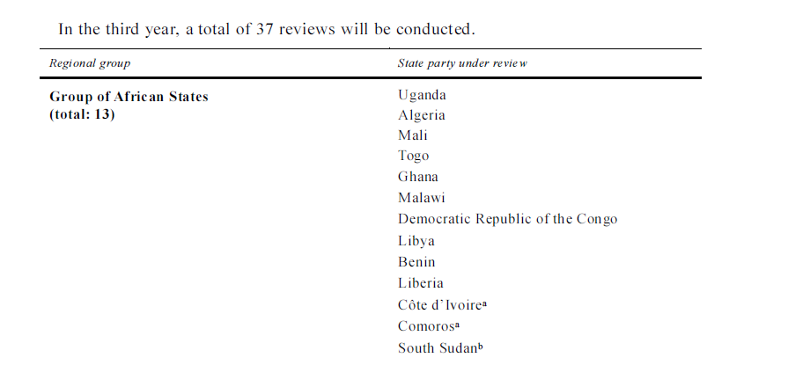
COUNTRY REVIEW STATUS
Country pairings for the second cycle of the Implementation Review Mechanism

Slide 7
UNODC PROJECT GLOU68: ANTI-CORRUPTION COMPONENT
Current projects
Africa: Strengthening the Capacity of Civil Society Organizations in Africa to Combat Corruption and Contribute to the UNCAC Review Process: Phase 3 (2017-2021)
Southeast Europe Regional Programme on Strengthening the Capacity of Anti-corruption Authorities and Civil Society to Combat Corruption and Contribute to the UNCAC Review Process (2015-2018)
Knowledge and Capacity
Financial support
Network and Dialogue
GLOU68 Outcomes
Since 2011, 15 trainings organized on UNCAC (CSO, multi-stakeholder and fast-tracking workshops)
Some 320 CSOs from over 105 countries trained through Workshops on UNCAC; organized jointly with the UNCAC Coalition
NGO Briefing Sessions, Side Events and facilitation of the participation of NGOs to UNCAC-related intergovernmental meetings
26 Grants provided through the private sector Grants Scheme Initiative

Slide 8
Civil Society TEAM
unodc-ngounit@un.org
+43 1 26060 5582
Thank you for your attention!

