Slide 1
PARTICIPATIng in, reporting on and conducting advocacy around the review process
Ádám földes – transparency international
Saly, Senegal, 11 May 2018
Email: afoldes@transparency.org

Slide 2
Why is the UNCAC review useful for me?
Notes:
- cross-cutting issues: right to information, protection of whistleblowers, codes of conduct, integrity of the judiciary, fair business sector

Slide 3
OK, but how to put it into practice?
Notes:
- cross-cutting issues: right to information, protection of whistleblowers, codes of conduct, integrity of the judiciary, fair business sector

Slide 4
Advocacy plan
Picking a winning issue
Problem tree
Solution tree
Stake-holder analysis
Actions
Risk analysis
Resources
Developing an anti-corruption advocacy plan - a step-by-step guide:
http://uncaccoalition.org/resources/advocacy/developing-an-advocacy-plan-a-step-by-step-guide-transparency-international.pdf

Slide 5
OBJECTIVES of csos IN THE REVIEW
WHY GET INVOLVED?
Build public awareness of UNCAC obligations
Communicate expectations about performance
Enhance accuracy of assessment
Demonstrate role of civil society in anti-corruption
Use official platform for outreach to
Government
National public
International community

Slide 6
STAGES & entry points
WHEN CAN CSOs GET INVOLVED?
Notes:
Photo: Flickr, USDA by Lance Cheung.

Slide 7
STAGES & entry points
WHEN CAN CSOs GET INVOLVED?
Self-assessment (input and publish)
Country visit or otherwise review team assessment and CSO input
Publication of the review report
Follow-up to review
Transparency & participation: All optional—but needed

Slide 8
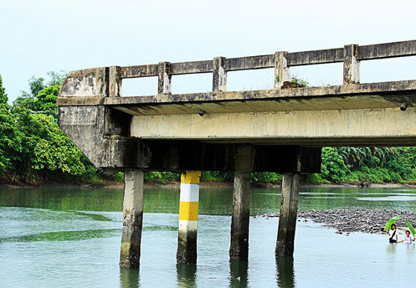
Areas for NGO involvement
WHAT SUBJECT MATTER?
Process issues: Advocate & monitor
Transparency
CSO participation
Content issues: Monitor & advocate
Access to information
Implementation through laws and regulations
Application and enforcement of laws and regulations, including data

Slide 9
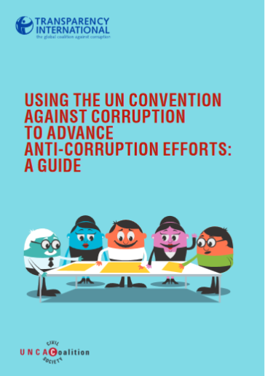
Cso monitoring & advocacy
WHAT TYPE OF INVOLVEMENT?
Advocate transparent & inclusive process – and monitor process
Public information—need to know focal point & timetable
Consultation
Prompt publication of reports
Prepare inputs to the assessment including for review team
Comment on process and results
Contribute to & comment on follow-up

Slide 10
Publication of FULL REVIEW REPORTS
Self-assessments published by: Nigeria (also in 2nd cycle)
Full 1st cycle reports published by
Niger, Nigeria, Malawi
Not published yet by Benin, Côte d’Ivoire, Gabon, Ghana, Liberia, Mali, Senegal,Togo
Not ready with executive summary / 1st cycle yet
Comoros, Congo Brazzaville, Democratic Republic of Congo, South Sudan
Not published by
Benin, Comoros, Congo Brazzaville, Côte d’Ivoire, Democratic Republic of Congo. Gabon, Ghana, Liberia, Malawi, Mali, Niger, Senegal, South Sudan, Togo

Slide 11
discussion
What’s your experience?

Slide 12
www.transparency.org
facebook.com/transparencyinternational
twitter.com/anticorruption
blog.transparency.org
© 2018 Transparency International. All rights reserved.

