Slide 1
UNODC SMALL GRANTS SCHEME
5th round –Summer 2018
Viktorija Nesterovaite Consultant, UNODC

Slide 2
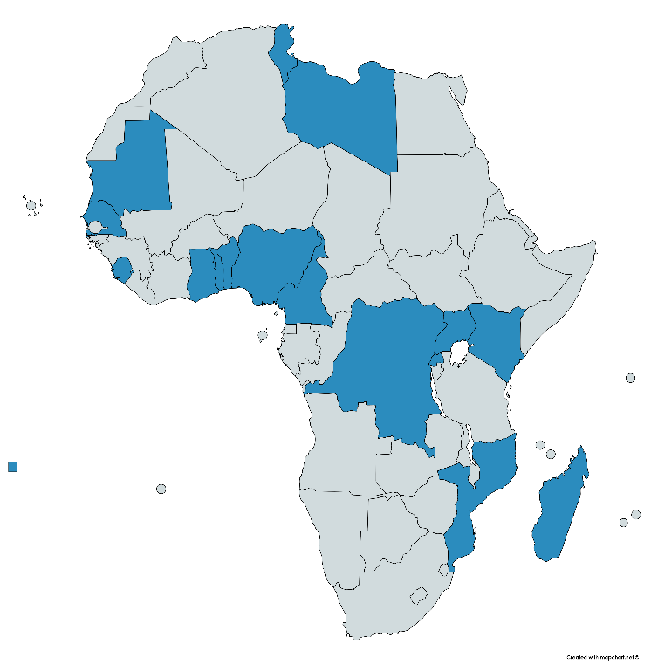
Small Grant Recipients
26 CSOs from 16 countries supported in the first 4 rounds since 2012
In the last round (July –November 2015) 9 CSOs from 8 countries were selected: Benin - Cameroon – Kenya – Madagascar Rwanda – Senegal – Togo – Uganda

Slide 3
UNODC Small Grants Scheme
Small Grants aim at assisting Civil Society Organizations in their engagement with the private sector in anti-corruption
Raise awareness among businesses about the UNCAC and its application at the local level

Slide 4
Why partner with the private sector ?
Private sector accounts for about 60% of the GDP globally
About 10% of private sector companies are MNCs and their sales are worth US $31 trillion – 90% are SMEs
Private sector is increasingly providing services that were previously provided by the State
Actors of private sector are not only victims of corruption but part of the solution

Slide 5
Why CSOs should encourage SMEs to work on UNCAC?
Existence of a number of global initiatives and compliance programmes that partner with MNCs (e.g. UN Global Compact*, EITI, GSCP) * Principle 10: Businesses should work against corruption in all its forms, including extortion and bribery
A need to engage with SMEs at local level as they represent 90% of gobal economy and are more difficult to reach
CSOs can play an important role in engaging SMEs on the implementation and monitoring of UNCAC

Slide 6
Criterias for CSO selection
CSOs based in Africa
Experience in monitoring activities, conducting legal analysis, drafting reports, and working with the private sector
Advocacy experience in sectorial industries (e.g. extractive industries, construction industry, financial sector, etc.)
Organization’s potential to make useful contributions to the review process and country/regional follow-up activities

Slide 7
Project parameters
Scope
Timescale
Quality
Costs
Risks
Benefits

Slide 8
Grant Scheme Achievements
Empower CSOs to engage SMEs in the implementation of UNCAC
Involved marginalized groups such as women, disabled and indigenous people
Created local mechanisms such as action plans and business networks to combat corruption

Slide 9
Success Story: Transparency International-Sierra Leone
Location: Western Area, Freetown, Sierra Leone.
Target group: the media, civil society, the Sierra Leone Contractors Union and the Sierra Leone Indigenous Business Association
Activities: radio discussions; a two-day workshop that involved all the above stakeholders; dissemination of campaign material to 1,000,000 residents in the Western Area of Freetown.
Results achieved: Increased knowledge and skills on the UNCAC, Anti-Corruption Act of Sierra Leone 2008 and the prevention of corruption

Slide 10
Next Round of Small Grants
In the summer 2018, six grants of USD 5000 will be distributed to African CSOs
The call for applications will be published on the UNODC webpage
Send you applications to unodc-ngounit@un.org

Slide 11
How to contact us:
Civil Society Team
unodc-ngounit@un.org
+43 1 26060-5582
_______________________________________ Thank you for you attention!

