Slide 1
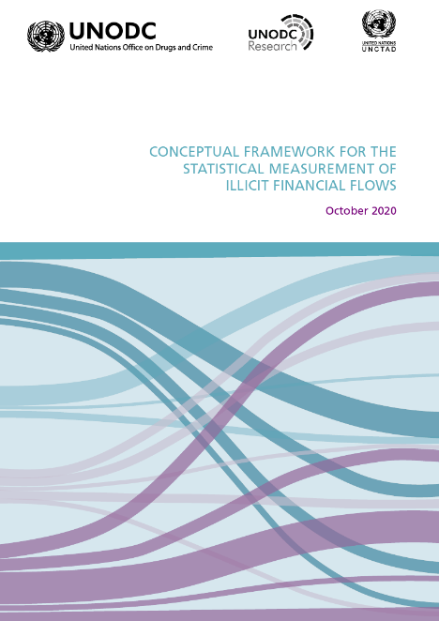
UNCTAD-UNODC
Conceptual framework for the statistical measurement of Illicit Financial Flows
Enrico Bisogno
Chief, Data Development and Dissemination Section
UNODC

Slide 2
IFFs at the crossroad of multiple policy agendas
Instrument for tax evasion or avoidance
loss of public resources
Instrument for committing/facilitating corruption
rule of law erosion
Vehicle to foster illegal markets or invest related proceeds
weakening of justice system and rule of law
Vehicle to finance terrorism
threat to state security

Slide 3
The framework: 2030 Agenda
Goal 16 – Promote peaceful and inclusive societies for sustainable development, provide access to justice for all and build effective, accountable and inclusive institutions at all levels
Target 16.4: By 2030, significantly reduce illicit financial and arms flows, strengthen the recovery and return of stolen assets and combat all forms of organized crime
Indicator 16.4.1: Total value of inward and outward illicit financial flows (in current US Dollars)
UNODC and UNCTAD, as co-custodians of indicator 16.4.1, are mandated to develop the statistical methodology

Slide 4
IFFs for statistical purposes
Monetary measure of:
International transfers of illicitly earned capital
(Originally) legal capital transferred internationally for illicit purposes
(Originally) legal capital transferred illicitly
Core Elements:
Illicit
Cross-Border
not domestic
Flows
no stocks
no net flows

Slide 5
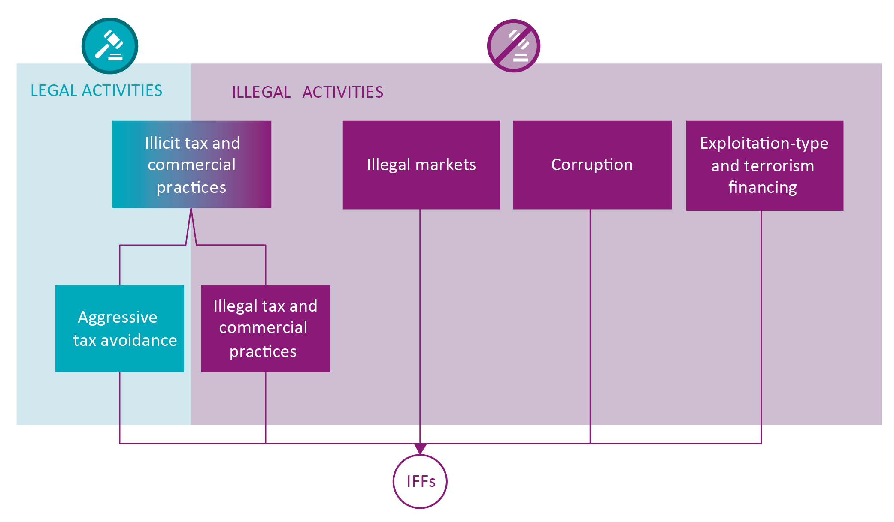
Distinguishing four types of IFFs

Slide 6
IFFs from illegal markets/activities
Illegal markets
Corruption
Exploitation-type and terrorism financing
Drug trafficking
Firearm trafficking
Illegal mining
Smuggling of migrants
Smuggling of goods
Wildlife trafficking
…
Bribery
Embezzlement
Abuse of functions
Trading in influence
Illicit enrichment
Other acts of corruption
Kidnapping
Slavery and exploitation
Trafficking in persons
Sexual exploitation
Extortion
Robbery
Burglary
Theft
Financing of terrorism
Productive activities
Non productive activities

Slide 7
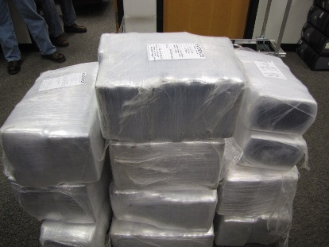
Example: IFFs emerging from drug trafficking
Drug importing and consumption country
IFF
IFF
Drug processing, wholesale and retail sale
Value is generated

Slide 8
Dual Focus in Measuring IFFs
Income Generation
Income Management
Illicit financial flows connected to illicit markets and their functioning
Linked to transnational supply and demand of illicit goods and services
Illicit financial flows to manage income generated from illicit activities
Linked to consumption and investment patterns of illicit actors

Slide 9
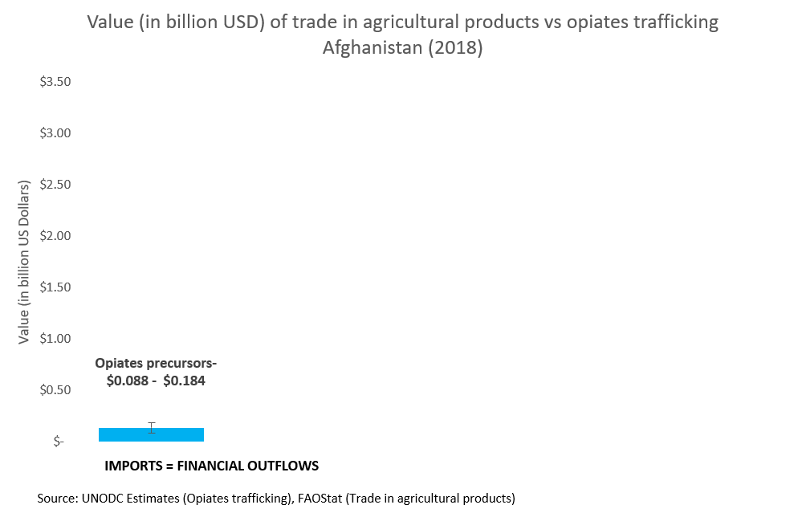
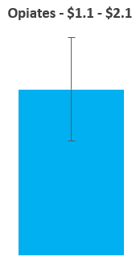
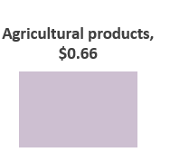
IFF from opiates trafficking, Afghanistan (income generation)

Slide 10
Statistical Framework for Measuring IFFs
Key features:
Country-Level: Allows to measure IFFs at the level of countries (in line with SDG indicator framework)
Disaggregated: separate estimates for each IFF type
Comprehensive: Encompasses main types of illicit activities that cause IFFs
Compatible: Aligned to established concepts and standards from economics and accounting

