Slide 1

Education for Justice (E4J)
Integrity and Ethics
Module 4: Ethical Leadership

Slide 2
Agenda
Introduction to leadership (5 minutes)
Leader’s view exercise (20 minutes)
Definition of leadership and ethical leadership (5 minutes)
Why do leaders have ethical responsibility? (10 minutes)
Importance of ethical leadership for effective leadership (25 minutes)
Class exercises (60 minutes)
Applying ethical theories, principle and models to leadership (30 minutes)
Turning knowledge into practice (25 minutes)

Slide 3
Learning Outcomes
Upon completion of this module students should be able to:
Define and give examples of ethical leadership
Understand leaders’ ethical responsibilities
Explain effective ethical leadership
Assess ethical leadership
Identify ways to promote ethical leadership

Slide 4
Introduction to leadership
What is ethical leadership?
Why is ethical leadership important?
How to promote ethical leadership.

Slide 5
Exercise I
LEADER’S VIEW

Slide 6
Definition of leadership and ethical leadership
Components of leadership:
  Leadership is a process
  Leadership involves influence
  Leadership occurs in groups
  Leadership involves common goals
Ethical leadership:
  “setting and pursuing ethical goals and influencing others in an ethical manner”
  “influencing the activities of a group toward goal achievement in a socially responsible way”

Slide 7
Why do leaders have ethical responsibility?

Slide 8
The importance of ethical leadership
The ‘interpersonal trust’ model developed by Schindler and Thomas
The ‘social power’ model developed by French and Raven

Slide 9
Class exercises
E2: Decision cards
E3: Pop culture examples of ethical leadership
E4: “Telling the truth” (case study)
E5: “Stay neutral or not” (case study)

Slide 10
Applying ethical theories, principle and models to leadership
Core Ethical Theories and how they apply to ethical leadership
 | Utilitarianism | Deontology | Virtue
Morality depends on… | Consequences “cost / benefit” | Conformity to moral principles | Perfecting one’s character
Key philosophers | Mill, Bentham | Kant | Aristotle
Jargon | Greatest Happiness Principle | Categorical Imperative | Telos

Slide 11
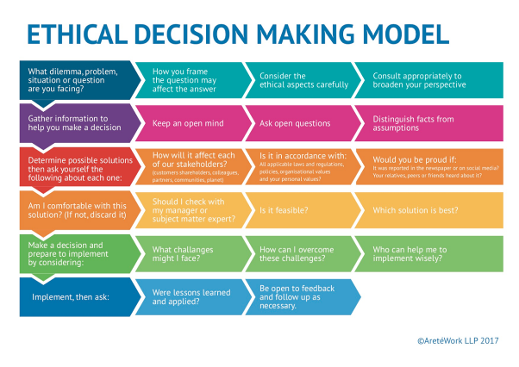
Applying ethical theories, principle and models to leadership

Slide 12
Turning knowledge into practice (exercise)
Daft’s ten activities of a moral leader:
Develop, articulate, and uphold high moral principles.
Focus on what is right for the organization as well as all the people involved.
Set the example you want others to live by.
Be honest with yourself and others.
Drive out fear and eliminate issues that cannot be discussed.
Establish and communicate ethics policies.
Develop a backbone - show zero tolerance for ethical violations.
Reward ethical conduct.
Treat everyone with fairness, dignity, and respect, from the lowest to the highest level of the organization.
Do the right thing in both your private and professional life - even if no one is looking
Northouse’s five principles of ethical leadership:
Ethical Leaders Respect Others
Ethical Leaders Serve Others
Ethical Leaders Are Just
Ethical Leaders Are Honest
Ethical Leaders Build Community

Slide 13
Core reading
What is ethical leadership? Available from https://www.villanovau.com/resources/leadership/what-is-ethical-leadership/#.WsZCAWaB01g
What is a leader? Available from http://www.leadership-central.com/what-is-a-leader.html#axzz5Bo39Ro00
What is ethics? Available from http://www.ethics.org.au/about/what-is-ethics

