Slide 1

Education for Justice (E4J)
Integrity and Ethics
Module 9: Gender Dimensions of Ethics

Slide 2
Agenda
Class overview (15 minutes)
Ethics of Care (25 minutes)
Gender discrimination (40 minutes)
Balancing self and other (30 mins)
Implicit gender bias (30 minutes)
Sexual harassment online and at work (30 mins)
Conclusion (10 minutes)

Slide 3
Learning Outcomes
Upon completion of this module students should be able to:
Define gender, gender discrimination, intersectionality, and the Ethics of Care theory
Understand the ways in which people are marginalized based on gender, and the ways in which gender intersects with other structures of power
Detect sexism in one’s everyday life and understand the ways one can combat it individually and collectively
Understand feminism and feminist ethics in their historical context
Apply the Ethics of Care theory to address and prevent gender discrimination
Demonstrate what it means in one’s own everyday life to take a moral position against gender discrimination

Slide 4
Introduction to the gender dimensions of ethics
Basic terms: gender and gender discrimination
Ethics of Care in historical context

Slide 5
Ethics of Care
Key characteristics of Ethics of Care (EoC):
The complexity and variation in degrees of dependence and interdependence between people and institutions over time are acknowledged and considered.
Those people particularly impacted by our choices need to be considered carefully in our decision-making. Those especially vulnerable deserve extra consideration, love and care.
Rather than relying on a “blanket” or “one size fits all” approach, it is necessary to attend to contextual details of situations in order to safeguard and promote the actual specific interests of those involved.

Slide 6
Gender discrimination
Forms of gender discrimination:
  Sexism
  Implicit sexism
  Sexual harassment
  Sexual assault

Slide 7
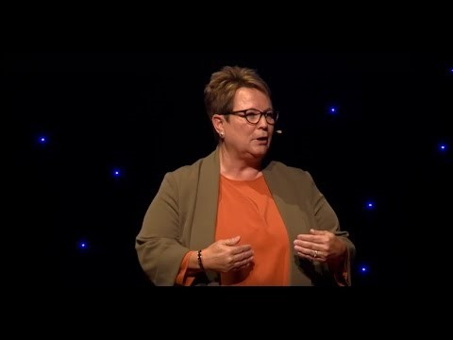

Gender discrimination (exercises)
E1: Privilege is invisible to those who have it
E2: The power walk (role play)
Notes:
To enable the videos in a slideshow mode please follow these steps:
Click “Enable Content” in the yellow line at the top of the window (if it appears).
Click with the right button of the mouse on each video and select “Preview” from the drop-down menu.
Wait few seconds until the video loads

Slide 8
Balancing self and other
How to determine where to start– and stop – caring?
How to implement EoC approach in our own lives in everyday situations involving gender inequality?
How to address our own implicit gender-based biases

Slide 9

Balancing self and other (exercise)
E3: Self vs. other
Notes:
To enable the video in a slideshow mode please follow these steps:
Click “Enable Content” in the yellow line at the top of the window (if it appears).
Click with the right button of the mouse on the video and select “Preview” from the drop-down menu.
Wait few seconds until the video loads

Slide 10
Implicit gender bias
E4: The “Gender-Career Implicit Associations Test”
E5: Gender equity in recruitment advertisements (“Gender Decoder”)

Slide 11


Sexual harassment online and at work
E6: Sexual harassment online
E7: Sexual harassment at work
Notes:
To enable the video in a slideshow mode please follow these steps:
Click “Enable Content” in the yellow line at the top of the window (if it appears).
Click with the right button of the mouse on the video and select “Preview” from the drop-down menu.
Wait few seconds until the video loads

Slide 12
Class wrap up – “Minute Paper”
What was the most important thing you learned today?
What question remains in your mind?

Slide 13
Core reading
Crenshaw, Kimberle (1991). Mapping the margins: intersectionality, identity politics, and violence against women of color. Stanford Law Review, vol. 43, No. 6, pp. 1241-1299.
Gaucher, Danielle, Justin P. Friesen and Aaron C. Kay (2011). Evidence that gendered wording in job advertisements exists and sustains gender inequality. Journal of Personality and Social Psychology, vol. 101, No. 1, pp. 109-28.
Gilligan Carol (1982). In a Different Voice. Cambridge: Harvard University Press. » See especially pp. 24-39.
Mohanty, Chandra T. (2003). 'Under western eyes' revisited: feminist solidarity through anticapitalist struggles. Signs vol. 28, No. 2, pp. 499-535.
National Women's Law Centre (2017). Equal Pay for Black Women.

Slide 14
Core reading II:
Noddings Nel. (1984). Caring: A Feminine Approach to Ethics and Moral Education . Los Angeles: University of California Press
Patil, Vrushali (2013). From patriarchy to intersectionality: a transnational feminist assessment of how far we've really come. Signs: Journal of Women in Culture and Society, vol. 38, No. 4, pp. 847-867.
Sander-Staudt, Maureen (2018). Care Ethics. The Internet Encyclopaedia of Philosophy.
Tronto, Joan (2005). An ethic of care. In Feminist theory: a philosophical anthology, Ann E. Cudd and Robin O. Andreasen, eds. Malden, Massachusetts: Blackwell Publishing.
Tronto, Joan C. (2010). Creating caring institutions: politics, plurality, and purpose. Ethics and Social Welfare, vol. 4, pp. 158-71.
UN Women (2017). Facts and Figures: Ending Violence Against Women .

