Slide 1
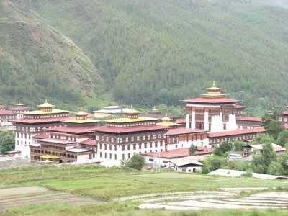
REGIONAL PROJECT STEERING COMMITTEE MEETING “Prevention of Transmission of HIV among drug Users in SAARC Countries” Project RAS/H13 at Colombo, Sri Lanka 17 May, 2012
Country Report
By :
S.P.Pradhan,BNCA, Thimphu

Slide 2
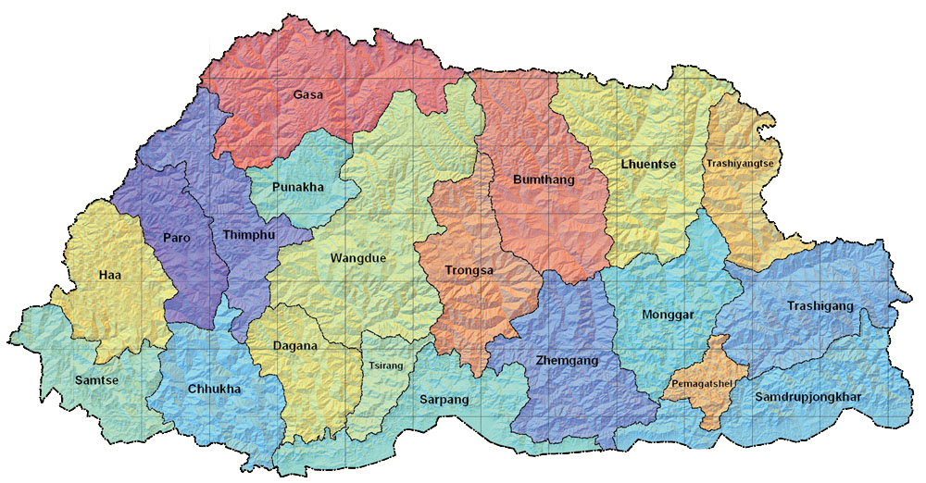
BHUTAN Land of Gross National Happiness

Slide 3
Project progress update since 2010
Addressing legal policy issues:
Amendment of Narcotic Drugs Psychotropic Substance Abuse Act 2005 under Demand Reduction Services.
Chapter V : Educational Measures
Chapter VI : Treatment and Rehabilitation

Slide 4
Service delivery strengthening/expansion
Opening up of 3 new Drop In Centers at Samdrup Jongkhar, Mongar (managed by BNCA) and Bumthang (managed by NGO-YDF)
Capacity building/institutional strengthening
Recruitment and training of Peer Counsellors
Evidence generation
Report on HIV/AIDS Epidemic Updates [ July to Dec 2011] from the Ministry of Health.
Need Assessment Report 2011 by LHAKSAM, NGO to understand the circumstances and growing need of Bhutanese living with HIV/AIDS.

Slide 5
Present national drug use and drug use related HIV scenario
No. of injecting drug users
As per NBA 2009, report of 98 male IDU in 12 Dzongkhags, 31 regular user.
No. of drug users with HIV infection
3 IDUs with HIV
No. of drug users with other comorbid/health conditions
Information not available.
Geographical spread (drug use/HIV)
270 HIV cases reported till Dec 2011: 50% male, 50% female all over the country.

Slide 6
Reported cases of drug abuse from 2001 to 2011

Slide 7
Gender-wise reported cases of drug abuse from 2001 to 2011

Slide 8
No. of offences substance-wise for 2001 to 2011

Slide 9
No. of overdose death cases from 2008 to Jan. 2012

Slide 10
Number of persons arrested by police for use of pharmaceutical preparation containing NDPS
Year/ No. of offences | 2001 | 2002 | 2003 | 2004 | 2005 | 2006 | 2007 | 2008 | 2009 | 2010 | 2011 | Total
No. of offences reported | 20 | 12 | 27 | 42 | 24 | 23 | 53 | 111 | 137 | 174 | 200 | 823

Slide 11
Present national drug use and drug use related HIV response Drug use prevention treatment and care services
Number of males who have undergone rehab program at Serbithang from 2009 till 2012
Type, reach/coverage
Categories | Type of Users |  |  | Total treated and discharged
 | Drugs | Alcohol | Poly Users
Total | 26 | 58 | 49 | 133

Slide 12
Number of females who have undergone rehab program at Serbithang from 2010 till March 2012
Categories | Type of Users |  |  | Total treated and discharged
 | Drugs | Alcohol | Poly Users
Total | 5 | 43 | - | 48

Slide 13
Number of clients detoxed at Psychiatric Ward, JDWNRH, Thimphu in 2011
No. of cases | Male | Female | Alcohol dependents |  | Drug dependent |  | Poly Users |  | Rehabilitated
 |  |  | Male | Female | Male | Female | Male | Female | Male | Female
293 | 251 | 42 | 186 | 38 | 10 | 0 | 54 | 4 | 47 | 18
 |  |  | 224 |  | 10 |  | 58 |  | 65

Slide 14
HIV prevention treatment and care services
Voluntary Counselling and Testing facility available at health centres
Any other health care/psycho social services
Health Information and Service Centres at urban town
Services for any special/new populations
Information not available
Coordination arrangements – steering committees for project management, on OST/NSP etc
BNCA along with relevant stakeholders at the national level, MSTF in district level and Village Health Workers at gewog level.

Slide 15
How has the project been catalytic in the Drug use/HIV national response/s
National Baseline Assessment 2009
Capacity building of the service providers
Development of guidelines and protocols for DIC and the rehab centres
Out Reach based Harm reduction services through the peer counsellor
distribution of condoms and encourage drug users for voluntary testing and counselling.
Collaborate with HISC and provide service to the clients.

Slide 16
The way forward…
Policy harmonisation/reforms/changes
Streamlining the legislation [NDPSSA Act & its Rules and Regulation] and in particular to Harm Reduction.
Evidence generation
Next NBA in 11 FYP, if fund available
Services: increasing coverage /targets
Establishment of 50 bedded rehab centre at Tshaluna in 11 FYP. 20 Acres of land acquired. Looking for donor.
Establishment of new DIC.
Capacity building
All stakeholders including NGOs through multilateral and bilateral arrangements and regional cooperation: GOI, TICA, Colombo Plan, UNODC etc.

Slide 17
The way forward…
Pilot OST in Thimphu for opoid users
Advocacy
Through mass media - both audio and print media from time to time. Eg. Frequent panel discussion or notification on the destruction of marijuana. plants etc. New initiatives/innovations
Grooming of new NGO like Chethen Phenday Association (CPA) in 2012 and Lhaksam – People living with HIV (PLHIV) in 2009.
Carrying out research/studies and maintain high degree of professionalism.

Slide 18
Problem areas
Porous border with India and difficult to control.
Sizeable youth population vulnerable to drug and HIV.
Rise in abuse of pharmaceutical preparation containing NDPS, especially dextro propxyphene based drugs prone to be injected around world.
Increase in injecting drug use as per the number of arrest made by Police for the last few years. Increase in gang fight, stabbing cases reported in media almost every day.
UNICEF support until Dec 2012.

Slide 19
Tashi Delek
(THANK YOU)

