Slide 1
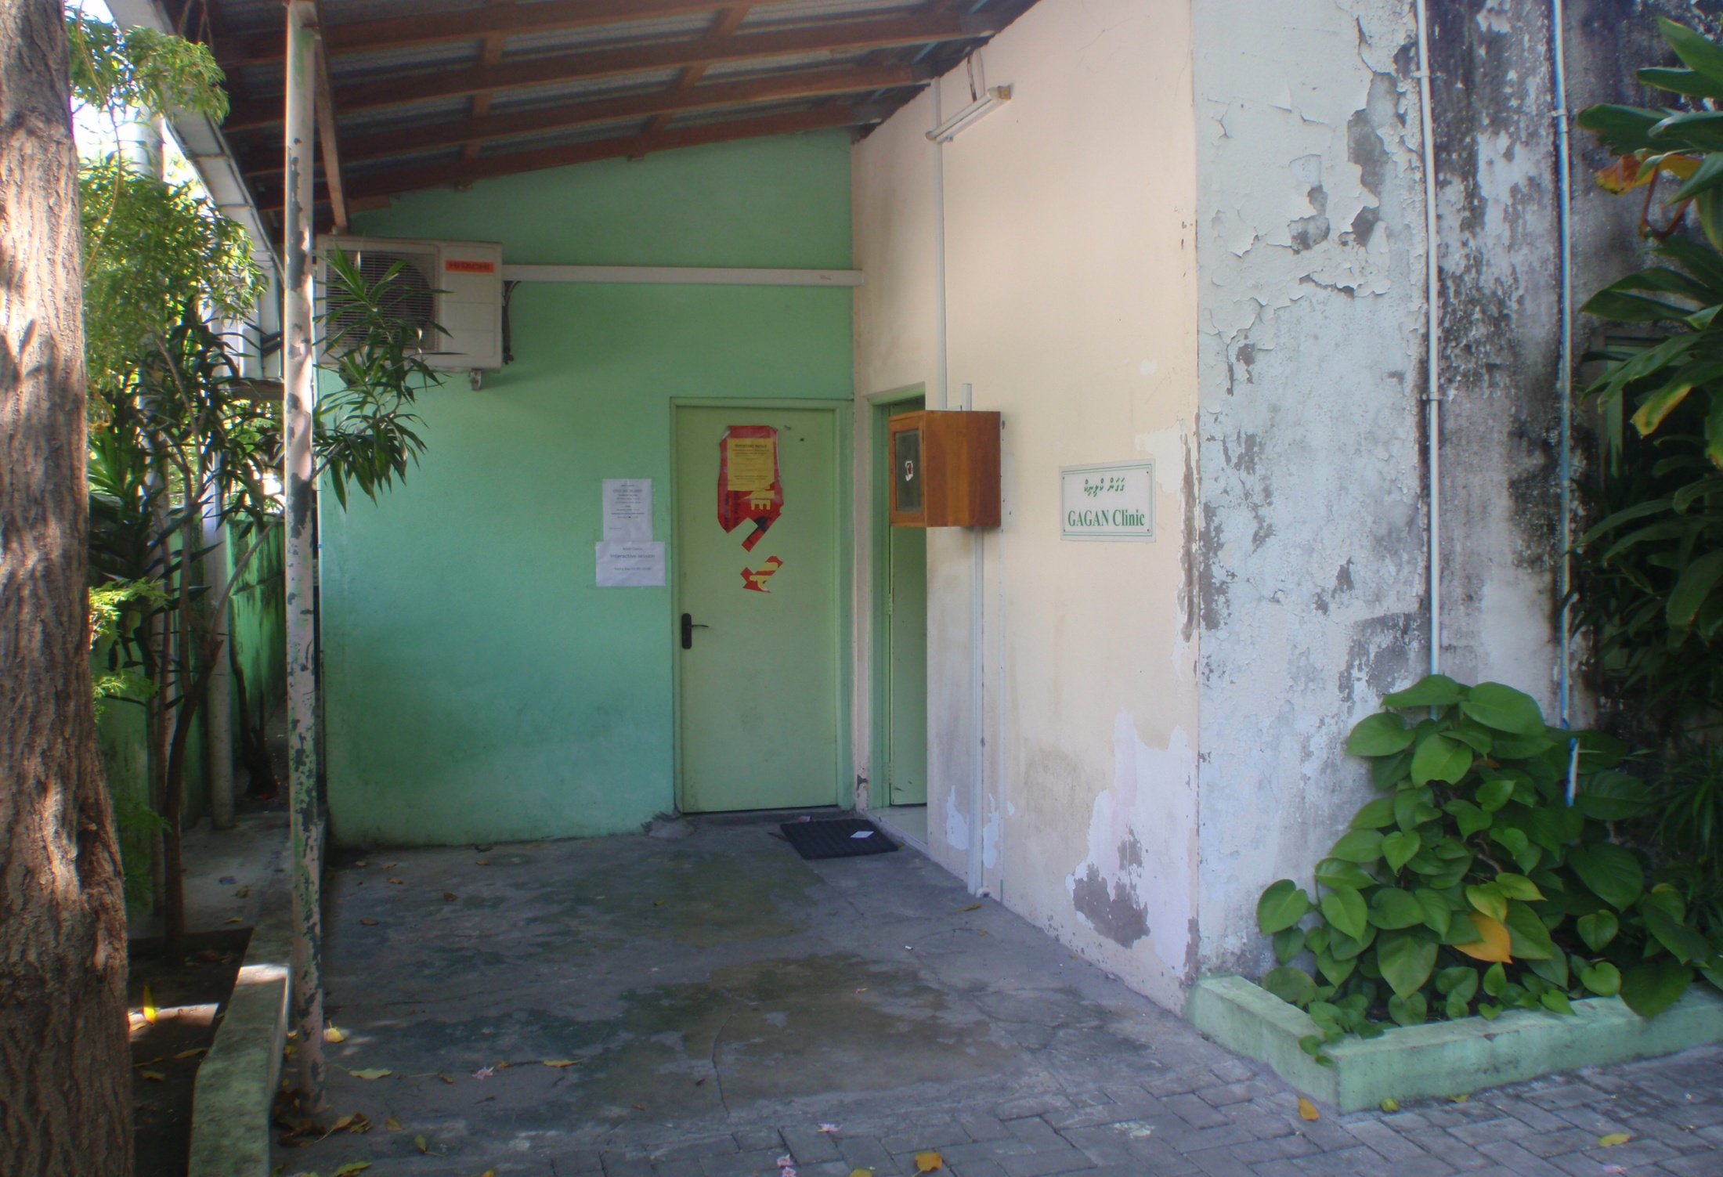
Project RAS/H13 “Prevention of transmission of HIV among drug users in SAARC Countries”
Lubna Mohamed Zahir Hussain
Chairperson of National Drug Agency Board
Minister of State for Health

Slide 2
Methadone Maintenance Program
MMT was Initiated as a 9 month pilot project on 16th October 2008 by the Government of Maldives, with the support of the UNODC.
The first Training and capacity building was done by Consultant Psychiatrist Dr. Suresh Kumar.
A total of 12 patients were initiated into the MMT pilot project at the start.
A total of 60 patients were originally expected to be initiated into the Pilot project.
It took 3 years, 9 months and 23 days to reach the number ‘60’

Slide 3
Role of NGO
Journey
Provides peer support for MMT patients
Has a drop in center (DIC) where patients can spend their time
Society for Women Against Drugs (SWAD)
Provides family counseling and support for MMT patients
Provides vocational training and also assists in job placements
Society for Health Education (SHE)
Conducts group sessions and psychosocial classes for MMT patients.
Helps in vocational rehabilitation of MMT patients and provides them job placement
Conducts house visits
Provides drug education for the co-dependents of MMT patients
Conducting sessions for MMT clients.
Provides family counseling and support for MMT patients
Provides vocational training and also assists in job placements
Conducts house visits
Provides drug education for the co-dependents of MMT patients

Slide 4
Project progress update (since 2010)...

Slide 5
Addressing legal policy issues?
Strong Political Commitment
New Drug Law 17/2011
accepts harm reduction initiatives
Therefore policy issues faced
NO

Slide 6
Service delivery strengthening/expansion
No. of clients seeking help increased.
Drug Law 17/2011 allows private harm reduction center's (OST Program).

Slide 7
Capacity building/institutional strengthening
26 Dec 2010
Trained the staff of DDPRS (NDA) and NGO’s
7 - 9 September 2011,South Asia Regional OST Workshop was held at Paradise Island Hotel, Maldives
This area needs improvement

Slide 8
Evidence Generation
Only evidence generated is through urine testing's of clients seeking MMT services

Slide 9
Urine test Results
5 Month Urine Analysis in 2011 (February, March, April & May) | %
Urine tests negative to Opioids according to the urine analysis on 13th Feb 2011 | 65.79%
Urine tests negative to Opioids according to the urine analysis on 8th Mar 2011 | 66.67%
Urine tests negative to Opioids according to the urine analysis on 25th Apr 2011 | 77.14%
Urine tests negative to Opioids according to most recent urine analysis on 7th Jun 2011 | 81.58%

Slide 10
MMT caters for a Special population
Female Drug Users in the program
14

Slide 11
Present national drug use and drug use related HIV scenario

Slide 12
The National drug Survey results will be established in June 2012
This results will allow us to know the no.of drug users in Maldives with the types of drugs they use. The no. of. Female drug users and injecting drug users.

Slide 13
Estimated figure of Help Seekers
Sector | No. of Cases
Prosecutor Generals Office | 1300
Criminal Court (Cases to be transferred to Drug Court) | 700
Maldives Police Services (Investigations on going and some cases to be sent to PGO) under arrest | 123
Drug Court (Cases that are already transferred by Criminal Court) | 18
Department of Penitentiary and Rehabilitation Services | 1216
Total number of cases estimated to be transferred to NDA | 3357

Slide 14
No. of drug users with HIV infection
Official Figure
Zero
VCT Figure
Zero
Unofficial Figure
One 23 year old (injecting Drug User/Female) passed away out of AIDS

Slide 15
No. of drug users with other comorbid/health conditions
36
Clients from MMT clinic

Slide 16
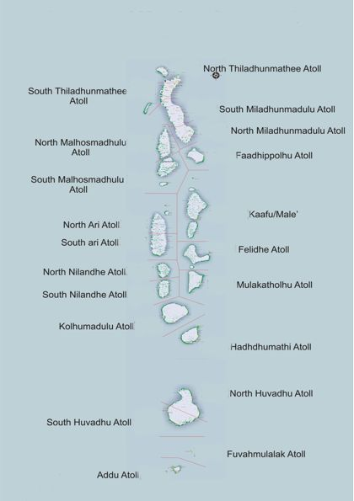
Geographical spread (drug use/HIV)
Drug Users

Slide 17
Services of NDA

Slide 18
Prevention
Harm Reduction
Treatment and Rehabilitation

Slide 19
Prevention Program
Safe Island Program
Drug Free Work Place
Drug Awareness Programs
IEC Material Development
Notes:
Safe island – selected islands to safeguard the environment from drugs and other issues related to drugs
Drug free workplace – focusing on the work environment of both government and non government providing information and training middle management staff to sustain the drug free workplace program (workplace drug free policy development)

Slide 20
Mandated Rehabilitation Centre's by Drug Law 17/2011
Drug Treatment and Rehabilitation Centre
Detoxification Center
ޑްDrug offender Remand Center
Female Treatment and Rehabilitation center
Halfway House
Children Treatment and Rehabilitation Center
Notes:
3-D rings
(Intermediate)
To reproduce the effects on this slide, do the following:
On the Home tab, in the Slides group, click Layout, and then click Blank.
On the Home tab, in the Drawing group, click Shapes, and then under Basic Shapes click Donut (third row, second option from the left). On the slide, drag to draw a donut shape.
Select the donut shape. Drag the yellow diamond adjustment handle to the left to decrease the width of the donut shape.
Under Drawing Tools, on the Format tab, in the Size group, do the following:
In the Shape Height box, enter 4.17”.
In the Shape Width box, enter 4.17”.
Under Drawing Tools, on the Format tab, in the Shape Styles group, click the arrow next to Shape Fill, and then under Theme Colors click Aqua, Accent 5, Darker 25% (fifth row, ninth option from the left).
Under Drawing Tools, on the Format tab, in the Shape Styles group, click the arrow next to Shape Outline, and then click No Outline.
Under Drawing Tools, on the Format tab, in the Shape Styles group, click the Format Shape dialog box launcher. In the Format Shape dialog box, click 3-D Format in the left pane, and then do the following in the 3-D Format pane:
Under Bevel, click the button next to Top, and then under Bevel click Convex (second row, third option from the left). Next to Top, in the Width box, enter 5 pt, and then in the Height box, enter 5 pt. Click the button next to Bottom, and then under Bevel click Convex (second row, third option from the left). Next to Bottom, in the Width box, enter 5 pt, and then in the Height box, enter 5 pt.
Under Depth, click the button next to Color, and then under Theme Colors click Aqua, Accent 5, Darker 25% (fifth row, ninth option from the left). In the Depth box, enter 30 pt.
Under Surface, click the button next to Material, and then under Special Effect click Soft Edge (second option from the left). Click the button next to Lighting, and then under Neutral click Three Point (first row, first option from the left). In the Angle box, enter 30°.
Also in the Format Shape dialog box, click Shadow in the left pane, and then do the following in the Shadow pane:
Click the button next to Presets, and then under Outer click Offset Diagonal Bottom Left (first row, third option from the left).
In the Blur box, enter 11 pt.
In the Angle box, enter 90°.
Also in the Format Shape dialog box, click 3-D Rotation in the left pane. In the 3-D Rotation pane, click the button next to Presets, and then under Parallel click Off Axis 1 Top (second row, third option from the left).
On the Insert tab, in the Text group, click Text Box. On the slide, drag to draw a text box.
Enter text in the text box (Note: Enter three spaces before and after the text), select the text, and then on the Home tab, in the Font group, select Franklin Gothic Medium from the Font list and then select 24 from the Font Size list.
On the Home tab, in the Paragraph group, click Center to center the text in the text box.
Select the text box. Under Drawing Tools, on the Format tab, in the WordArt Styles group, click Text Effects, point to Transform, and then under Warp click Can Down (fourth row, fourth option from the left).
Drag the text box onto the donut shape.
On the text box, drag the pink diamond and blue adjustment handles to adjust the amount of text warp so that it matches the curve of the donut shape.
Under Drawing Tools, on the Format tab, in the WordArt Styles group, click the arrow next to Text Fill, point to Gradient, and then click More Gradients. In the Format Text Effects dialog box, click Text Fill in the left pane, select Gradient fill in the Text Fill pane, and then do the following:
In the Type list, select Linear.
In the Angle box, enter 0°.
Under Gradient stops, click Add gradient stops or Remove gradient stops until three stops appear in the slider.
Also under Gradient stops, customize the gradient stops as follows:
Select the first stop in the slider, and then do the following:
In the Position box, enter 0%.
Click the button next to Color, and then under Theme Colors click White, Background 1 (first row, first option from the left).
In the Transparency box, enter 0%.
Select the next stop in the slider, and then do the following:
In the Position box, enter 30%.
Click the button next to Color, and then under Theme Colors click White, Background 1 Darker 15% (third row, first option from the left).
In the Transparency box, enter 0%.
Select the last stop in the slider, and then do the following:
In the Position box, enter 100%.
Click the button next to Color, and then under Theme Colors click White, Background 1, Darker 35% (fifth row, first option from the left).
In the Transparency box, enter 0%.
Press CTRL-A to select the shape and the text. One the Home tab, in the Drawing group, click Arrange, and then click Group.
Select the group. On the Home tab, in the Clipboard group, click the arrow to the right of Copy, and then click Duplicate.
Select the second shape group, and then, on the slide, drag it slightly above and to the right of the first donut shape.
Select the text in the second text box and edit the text.
Select the second donut shape. Under Drawing Tools, on the Format tab, in the Size group, do the following:
In the Shape Height box, enter 3.75”.
In the Shape Width box, enter 3.75”.
Drag the second text box onto the second donut shape.
On the second text box, drag the pink diamond and blue adjustment handles to adjust the amount of text warp so that it matches the curve of the second donut shape.
Select the second donut shape. Under Drawing Tools, on the Format tab, in the Shape Styles group, click the arrow next to Shape Fill, and then under Theme Colors click Purple, Accent 4, Darker 25% (fifth row, eighth option from the left).
Also under Drawing Tools, on the Format tab, in the Shape Styles group, click the Format Shape dialog box launcher. In the Format Shape dialog box, click 3-D Format in the left pane. In the 3-D Format pane, under Depth, click the button next to Color, and then under Theme Colors click Purple, Accent 4, Darker 25% (fifth row, eighth option from the left).
Press and hold CTRL, and then select the second donut shape and text box. On the Home tab, in the Clipboard group, click the arrow to the right of Copy, and then click Duplicate.
Drag the third donut shape and text box slightly above and to the left of the second donut shape.
Click the third text box and edit the text.
Select the third donut shape. Under Drawing Tools, on the Format tab, in the Size group, do the following:
In the Shape Height box, enter 3.33”.
In the Shape Width box, enter 3.33”.
Drag the third text box onto the third donut shape.
On the third text box, drag the pink diamond and blue adjustment handles to adjust the amount of text warp so that it matches the curve of the third donut shape.
Select the third donut shape. Under Drawing Tools, on the Format tab, in the Shape Styles group, click the arrow next to Shape Fill, and then under Theme Colors click Olive Green, Accent 3, Darker 25% (fifth row, seventh option from the left).
Also under Drawing Tools, on the Format tab, in the bottom right corner of the Shape Styles group, click the Format Shape dialog box launcher. In the Format Shape dialog box, click 3-D Format in the left pane. In the 3-D Format pane, under Depth, click the button next to Color, and then under Theme Colors click Olive Green, Accent 3, Darker 25% (fifth row, seventh option from the left).
Select the first donut shape. On the Home tab, in the Drawing group, click Arrange, and then click Send to Back.
To reproduce the background effects on this slide, do the following:
On the Design tab, in the Background group, click Background Styles, and then click Format Background. In the Format Background dialog box, click Fill in the left pane, select Gradient fill in the Fill pane, and then do the following:
In the Type list, select Linear.
In the Angle box, enter 270.
Under Gradient stops, click Add gradient stops or Remove gradient stops until two stops appear in the slider.
Also under Gradient stops, customize the gradient stops as follows:
Select the first stop in the slider, and then do the following:
In the Position box, enter 31%.
Click the button next to Color, and then under Theme Colors click White, Background 1 (first row, first option from the left).
In the Transparency box, enter 0%.
Select the next stop in the slider, and then do the following:
In the Position box, enter 100%.
Click the button next to Color, click More Colors, and then in the Colors dialog box, on the Custom tab, enter values for Red: 200, Green: 201, Blue: 193.
In the Transparency box, enter 0%.

Slide 21
Existing Rehabilitation Centers
Drug Treatment and Rehabitation Center
Detoxification center
female Treatment and Rehabilitation center
Notes:
3-D rings
(Intermediate)
To reproduce the effects on this slide, do the following:
On the Home tab, in the Slides group, click Layout, and then click Blank.
On the Home tab, in the Drawing group, click Shapes, and then under Basic Shapes click Donut (third row, second option from the left). On the slide, drag to draw a donut shape.
Select the donut shape. Drag the yellow diamond adjustment handle to the left to decrease the width of the donut shape.
Under Drawing Tools, on the Format tab, in the Size group, do the following:
In the Shape Height box, enter 4.17”.
In the Shape Width box, enter 4.17”.
Under Drawing Tools, on the Format tab, in the Shape Styles group, click the arrow next to Shape Fill, and then under Theme Colors click Aqua, Accent 5, Darker 25% (fifth row, ninth option from the left).
Under Drawing Tools, on the Format tab, in the Shape Styles group, click the arrow next to Shape Outline, and then click No Outline.
Under Drawing Tools, on the Format tab, in the Shape Styles group, click the Format Shape dialog box launcher. In the Format Shape dialog box, click 3-D Format in the left pane, and then do the following in the 3-D Format pane:
Under Bevel, click the button next to Top, and then under Bevel click Convex (second row, third option from the left). Next to Top, in the Width box, enter 5 pt, and then in the Height box, enter 5 pt. Click the button next to Bottom, and then under Bevel click Convex (second row, third option from the left). Next to Bottom, in the Width box, enter 5 pt, and then in the Height box, enter 5 pt.
Under Depth, click the button next to Color, and then under Theme Colors click Aqua, Accent 5, Darker 25% (fifth row, ninth option from the left). In the Depth box, enter 30 pt.
Under Surface, click the button next to Material, and then under Special Effect click Soft Edge (second option from the left). Click the button next to Lighting, and then under Neutral click Three Point (first row, first option from the left). In the Angle box, enter 30°.
Also in the Format Shape dialog box, click Shadow in the left pane, and then do the following in the Shadow pane:
Click the button next to Presets, and then under Outer click Offset Diagonal Bottom Left (first row, third option from the left).
In the Blur box, enter 11 pt.
In the Angle box, enter 90°.
Also in the Format Shape dialog box, click 3-D Rotation in the left pane. In the 3-D Rotation pane, click the button next to Presets, and then under Parallel click Off Axis 1 Top (second row, third option from the left).
On the Insert tab, in the Text group, click Text Box. On the slide, drag to draw a text box.
Enter text in the text box (Note: Enter three spaces before and after the text), select the text, and then on the Home tab, in the Font group, select Franklin Gothic Medium from the Font list and then select 24 from the Font Size list.
On the Home tab, in the Paragraph group, click Center to center the text in the text box.
Select the text box. Under Drawing Tools, on the Format tab, in the WordArt Styles group, click Text Effects, point to Transform, and then under Warp click Can Down (fourth row, fourth option from the left).
Drag the text box onto the donut shape.
On the text box, drag the pink diamond and blue adjustment handles to adjust the amount of text warp so that it matches the curve of the donut shape.
Under Drawing Tools, on the Format tab, in the WordArt Styles group, click the arrow next to Text Fill, point to Gradient, and then click More Gradients. In the Format Text Effects dialog box, click Text Fill in the left pane, select Gradient fill in the Text Fill pane, and then do the following:
In the Type list, select Linear.
In the Angle box, enter 0°.
Under Gradient stops, click Add gradient stops or Remove gradient stops until three stops appear in the slider.
Also under Gradient stops, customize the gradient stops as follows:
Select the first stop in the slider, and then do the following:
In the Position box, enter 0%.
Click the button next to Color, and then under Theme Colors click White, Background 1 (first row, first option from the left).
In the Transparency box, enter 0%.
Select the next stop in the slider, and then do the following:
In the Position box, enter 30%.
Click the button next to Color, and then under Theme Colors click White, Background 1 Darker 15% (third row, first option from the left).
In the Transparency box, enter 0%.
Select the last stop in the slider, and then do the following:
In the Position box, enter 100%.
Click the button next to Color, and then under Theme Colors click White, Background 1, Darker 35% (fifth row, first option from the left).
In the Transparency box, enter 0%.
Press CTRL-A to select the shape and the text. One the Home tab, in the Drawing group, click Arrange, and then click Group.
Select the group. On the Home tab, in the Clipboard group, click the arrow to the right of Copy, and then click Duplicate.
Select the second shape group, and then, on the slide, drag it slightly above and to the right of the first donut shape.
Select the text in the second text box and edit the text.
Select the second donut shape. Under Drawing Tools, on the Format tab, in the Size group, do the following:
In the Shape Height box, enter 3.75”.
In the Shape Width box, enter 3.75”.
Drag the second text box onto the second donut shape.
On the second text box, drag the pink diamond and blue adjustment handles to adjust the amount of text warp so that it matches the curve of the second donut shape.
Select the second donut shape. Under Drawing Tools, on the Format tab, in the Shape Styles group, click the arrow next to Shape Fill, and then under Theme Colors click Purple, Accent 4, Darker 25% (fifth row, eighth option from the left).
Also under Drawing Tools, on the Format tab, in the Shape Styles group, click the Format Shape dialog box launcher. In the Format Shape dialog box, click 3-D Format in the left pane. In the 3-D Format pane, under Depth, click the button next to Color, and then under Theme Colors click Purple, Accent 4, Darker 25% (fifth row, eighth option from the left).
Press and hold CTRL, and then select the second donut shape and text box. On the Home tab, in the Clipboard group, click the arrow to the right of Copy, and then click Duplicate.
Drag the third donut shape and text box slightly above and to the left of the second donut shape.
Click the third text box and edit the text.
Select the third donut shape. Under Drawing Tools, on the Format tab, in the Size group, do the following:
In the Shape Height box, enter 3.33”.
In the Shape Width box, enter 3.33”.
Drag the third text box onto the third donut shape.
On the third text box, drag the pink diamond and blue adjustment handles to adjust the amount of text warp so that it matches the curve of the third donut shape.
Select the third donut shape. Under Drawing Tools, on the Format tab, in the Shape Styles group, click the arrow next to Shape Fill, and then under Theme Colors click Olive Green, Accent 3, Darker 25% (fifth row, seventh option from the left).
Also under Drawing Tools, on the Format tab, in the bottom right corner of the Shape Styles group, click the Format Shape dialog box launcher. In the Format Shape dialog box, click 3-D Format in the left pane. In the 3-D Format pane, under Depth, click the button next to Color, and then under Theme Colors click Olive Green, Accent 3, Darker 25% (fifth row, seventh option from the left).
Select the first donut shape. On the Home tab, in the Drawing group, click Arrange, and then click Send to Back.
To reproduce the background effects on this slide, do the following:
On the Design tab, in the Background group, click Background Styles, and then click Format Background. In the Format Background dialog box, click Fill in the left pane, select Gradient fill in the Fill pane, and then do the following:
In the Type list, select Linear.
In the Angle box, enter 270.
Under Gradient stops, click Add gradient stops or Remove gradient stops until two stops appear in the slider.
Also under Gradient stops, customize the gradient stops as follows:
Select the first stop in the slider, and then do the following:
In the Position box, enter 31%.
Click the button next to Color, and then under Theme Colors click White, Background 1 (first row, first option from the left).
In the Transparency box, enter 0%.
Select the next stop in the slider, and then do the following:
In the Position box, enter 100%.
Click the button next to Color, click More Colors, and then in the Colors dialog box, on the Custom tab, enter values for Red: 200, Green: 201, Blue: 193.
In the Transparency box, enter 0%.

Slide 22
Coverage of Help Seekers through NDA services
Treatment Center | Existing No. of Clients | Total No. of clients seek help
K. Himmafushi Drug Rehabilitation Center (DRC) | 100 | 2913
Detoxification center | 11 | 580
Female Treatment and Rehabilitation Center | 2 | 2
Methadone Clinic | 84 | 232
Community Service Center (Male’) | 157 | 2146
Community Service Center (Fuahmulah) | 4 | 14
Community Drug Rehabilitation Center (Addu) | 11 | 67
Total | 369 | 5914

Slide 23
Coverage of help Seekers through HIV prevention treatment and care services (MMT Clinic)

Slide 24
New Services
Female Drug Treatment Center (recently started)
Children Treatment and Rehabilitation (to be started, Building is Identified, staffs will be trained soon)
Halfway house (staff training goin on, building construction is also progressing)

Slide 25
New Services
National Institute of Research and Addiction Studies (registered Higher Education Institute for staff and client development)
Starting of new treatment Initiate (Buprenorphine plus naloxone)
MMT Panel / Steering committee (Including JOURNEY, SWAD and NDA staff)

Slide 26
How has the project been catalytic in the Drug use/HIV national response/s

Slide 27
reduce Injecting Drug Usage
More attractive means of treating Drug Addicts
Addicts seeking help from MMT clinic has increased

Slide 28
Way Forward

Slide 29
Way Forward
Expansion of the clinic (Increasing the number of clients and starting OST program in other location)
Drug Law 17/2011 (allows private parties to start the service)
Analyze the success of existing service through Urine tests and no.of clients attending to jobs
New initiative Buprenorphine plus naloxone
NGO to conduct Advocacy to stakeholders
Training MMT clinic Staffs

Slide 30
Thank You

