Slide 1










Project Steering Committee Meeting
Colombo, 2012
RAS/H13: Prevention of transmission of HIV among drug users in SAARC countries

Slide 2
Contents
Brief Background of the project
Current scenario
Recommendations of Mid Term Review
Way forward

Slide 3
Background
Phase I (2003-2007) emphasised on developing the capacity in the region for scaling up HIV intervention among drug users
Project executed by UNODC ROSA, in partnership with governments and civil society in South Asia
Overall goal of H 13
To reduce the spread of HIV among drug using population in SAARC countries.
  assist governments and communities to scale-up comprehensive prevention and care programs for drug users, especially IDUs and their RSP’s

Slide 4
Phase I of the project
Prep phase
Programme phase
R
Track II
2003
2004
2005
2006
2007
Notes:
Only briefing on those projects with a green bullet.

Slide 5
Phase II - 4 key components
  Advocacy to support change in policy and practice
  Demonstrate the effectiveness of comprehensive risk reduction approaches to reduce HIV transmission among drug users, especially IDUs and their sexual partners
  Scaled up risk reduction approaches to reduce HIV transmission among drug users, especially IDUs and their regular sexual partners
  Project management

Slide 6
Phase II of the project
Prep
Programme phase
MTR
Programme phase (realigned)
Eval
2007
2008
2009
2010
2011
2012
2013
Notes:
Only briefing on those projects with a green bullet.

Slide 7
MALDIVES
Estimated IDU population
HIV prevalence among IDUs
INDIA
300-2000
NEPAL
16100- 28000
200000
0
20.7
BHUTAN
PAKISTAN
9.2
NA
130,460
Countries at a glance
BANGLADESH
SRI LANKA
0.1
10.8
20000-40000
NA
1.6
NA

Slide 8
Mid Term Review
Conducted in 2010
Purpose of Review:
Identify whether mid-course corrections in the design and implementation of the project need to be made in the light of new data and experience
Overall Objective:
  Review the progress of project implementation against the project's design and timelines.
  Provide recommendations to support mid-term correction of project activities.

Slide 9
Recommendations of MTR
Recommendations of MTR discussed at last PSC (2010)
Country focal points prioritized future steps based on MTR recommendations relevant in the present context

Slide 10
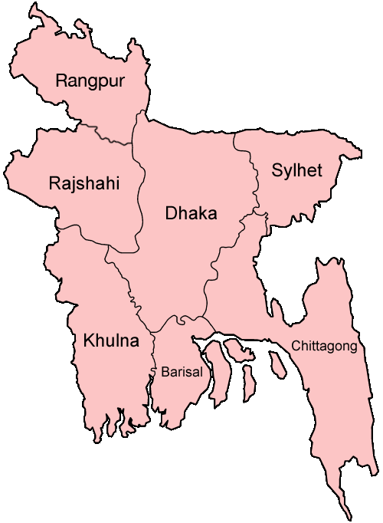
BANGLADESH

Slide 11
Present country scenario
93% IDU covered through NSEP
150 IDUs on MMT; expansion to 300 planned
IDUs included as ‘most at risk populations’ in National Strategic Plan for HIV and AIDS response (2011-15)
Narcotics Control Act, 1990 permits scientific and medical use of OST & NSEP

Slide 12
Actions on MTR recommendations
MTR:
Scale up MMT
PSC:
Set up 2 additional sites
-MMT pilot July 2010
-150 clients on MMT
-MMT to additional 150 clients in DIC setting planned

Slide 13
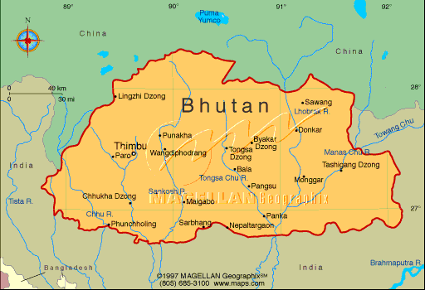
BHUTAN

Slide 14
Present country scenario
No NSEP
No OST. BNCA has requested support for a pilot OST
IDUs recognised as at risk group in the National Strategic Plan for the Prevention and Control of STIs and HIV and AIDS (2012-2016). NSP and OST listed as essential services for HIV prevention
Law does not directly criminalise possession or distribution of Needle syringe; Methadone and Buprenorphine can be dispensed with a license.

Slide 15
Actions on MTR recommendations
MTR:
Scale up Services
PSC:
Set up 2 additional HR sites
BNCA set up a rehab centre for female drug users.
3 new DICs set up; in total 6 running

Slide 16
Actions on MTR recommendations
MTR:
Build capacity
PSC:
Train health sector and civil society service providers
25 DIC and the rehab centre staff; 10 Government health workers trained on Harm Reduction

Slide 17
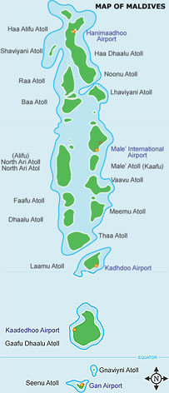
MALDIVES

Slide 18
Present country scenario
No NSEP
One MMT centre treats 70 opioid users.
National Operational Plan on HIV 2010-11, includes IDUs as the at risk population.Acknowledges the ‘right to health’ of persons using drugs
Interventions for drug users entrusted to the National Narcotics Control Bureau, Department of Prison and Rehabilitation and the Police.

Slide 19
Actions on MTR recommendations
MTR:
Scale up MMT
PSC:
Strengthen present Intervention
Set up 2 new sites
-70 clients presently on MMT. -Government planning to scale up MMT services for 400 drug users.
-SOP for MMT in Maldives prepared

Slide 20
Actions on MTR recommendations
MTR:
Build capacity
PSC:
Train health sector and civil society service providers
-4 NGOs (15 staff), 20 Govt. health workers trained on OST & psychosocial support for OST clients
-15 New NGOs (30 staff) trained on, project management.
-11 partners in MDV/K30.

Slide 21

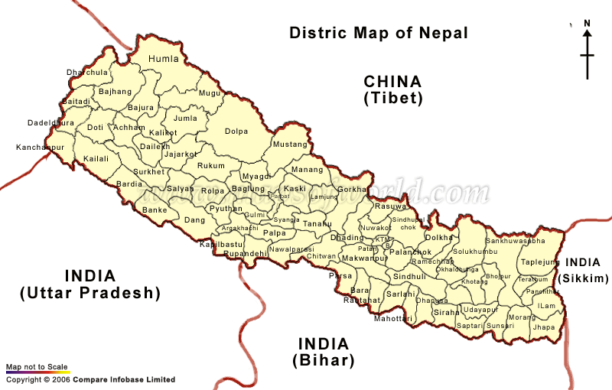

Slide 22
Present country scenario
10,811 IDUs receiving NSEP
OST for 800 IDUs
The National HIV Aids Strategy (2006-2011) endorses IDUs as a high risk group in need of services for HIV
Ministry of Home has endorsed Harm reduction and OST as essential services for Drug users
Distribution of sterile needles to IDUs may be construed as aiding and abetting consumption of drugs. Oral substitution may be permissible if recommended by a recognized medical practitioner.

Slide 23
Actions on MTR recommendations
MTR:
Scale up OST
PSC:
Scale up OST
-800 Clients on MMT from 3 centres
-Draft OST guidelines submitted to government for review

Slide 24
Actions on MTR recommendations
MTR:
Build capacity
PSC:
Train health sector and civil society service providers
-30 Health care provider trained on OST
-15 community members trained on Harm reduction

Slide 25
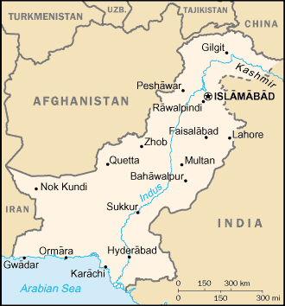
PAKISTAN

Slide 26
Present country scenario
11% IDUs receive NSEP
No OST
National HIV and AIDS Strategic Framework accept IDUs as a major risk group and proposes a package of services including NSEP, condom promotion and ART through NGO settings.
Supplying injecting equipment IDUs may be punishable as abetment of an offence under the Hadd order. OST be in contravention of the law, unless permitted within the exception of supply for medical treatment.

Slide 27
Actions on MTR recommendations
MTR:
Initiate OST
PSC:
Pilot OST
-Import permit secured
Procurement process initiated
-Quota granted by INCB
-Government hospitals selected for OST sites
-OST protocols and SOPs developed
-Work plan for OST programme drafted

Slide 28
Actions on MTR recommendations
MTR:
Build capacity
PSC:
Train health sector and civil society service providers
-Technical Working Group (TWG) under Country Programme established to build government’s capacity on comprehensive harm reduction services.

Slide 29
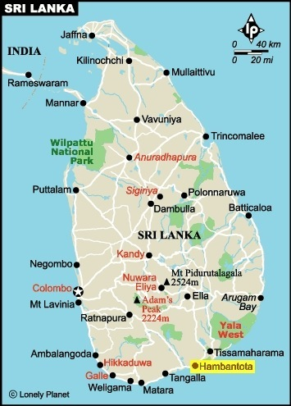
SRI LANKA

Slide 30
Present country scenario
No NSEP
No OST
The National Strategic Plan (NSP) for 2007-201 recognises IDUs as one of the high risk groups and allocates 28% of resources for prevention of HIV among the DUs.
. Possession of injection paraphernalia without medical prescription unlawful. Dispensing sterile needles to drug users may be construed as abetting illegal acts of possession or administering or delivering dangerous drugs without a license.

Slide 31
Actions on MTR recommendations
MTR:
Initiate OST for opioid user
PSC:
Pilot OST
-Advocacy with Ministry of Health and NDDCB
-Study tour of Sri Lankan delegation to OST sites in India
-High level meeting including Ministry of Health, civil society partners, UN partners

Slide 32
Actions on MTR recommendations
MTR:
Build capacity
PSC:
Train health sector and civil society service providers
-Advisory committee on drug addiction management established to assist Government.
-‘Refresher training programme for implementing partners’ conducted at Colombo

Slide 33
Funding
Overall budget: USD 16,551,700
Phase 1: USD 3,991,297
Phase 2: USD 12,560,403
Total Pledged Funds: USD 13,437,748
Phase 1: USD 3,991,297
Phase 2: USD 9,446,451
Funding shortfall: USD 3,113,952

Slide 34
Funding Support Phase I
Phase 1:
AusAID: USD 2,081,958
DFID: USD 1,549,339
SIDA: USD 360,000

Slide 35
Funding Support- donorwise
Phase 2:
AusAID: USD 7,488,304
GFATM: USD 822,417
GIZ: USD 411,842
PAF: USD 375,000
IND: USD 321,620
TISS: USD 27,268

Slide 36
AusAID Funding- UNODC component
Total Pledge: USD 7,488,304
Total collected: USD 7,488,304
To be collected: -

Slide 37
Tranches
1. AUD 2,124,738
2. AUD 2,542,428
3. AUD 2,376,612
4. AUD 1,972,782
5. AUD 445,555

Slide 38
AusAID Funding-per agency (USD)
 | UNAIDS | WHO | UNODC | Total
Pledged amount | 291,800 | 437,600 | 7,488,304 | 7,480,215
Collected amount | 240,529 | 299,394 | 7,488,304 | 6,165,776
Balance amount | 0 | 0 | 0 | 0

Slide 39
Budgets 2007-12 (Intervention cost with AusAID funds)
Country | 2007-08 | 2008-09 | 2009-10 | 2010-11 | 2011-12
Bangladesh | 94,000 | 104,000 | 292,200 | 292,200 | 146,100
Bhutan | 23,100 | 23,100 | 48,900 | 48,900 | 24,450
India | 16,000 | 122,700 | 0 | 0 | 0
Maldives | 31,000 | 74,000 | 60,000 | 60,000 | 30,000
Nepal | 214,000 | 883,100 | 658,700 | 658,700 | 329,350
Pakistan | 50,000 | 179,319 | 229,425 | 229,425 | 114,713
Sri Lanka | 176,000 | 180,000 | 160,000 | 160,000 | 80,000
Total | 604,100 | 1,566,219 | 1,449,225 | 1,449,225 | 724,613

Slide 40
Funds situation 2010-12
Funds required to sustain all interventions: USD 2,173,838
Funds Available: USD 1,124,962
Shortfall: USD 1,048,876

Slide 41
The way forward…
Option 1: An entirely New Regional Proposal to meet the present requirements
Option2: A proposal for Bridge Funding to complete the unfinished tasks
Option3: No cost extension to continue with the activities and move towards the new proposal

Slide 42

Thank you !

