Slide 2
A Presentation by Dr Qazi Mujtaba Kamal National Programme Manager National AIDS Control Programme

Slide 3
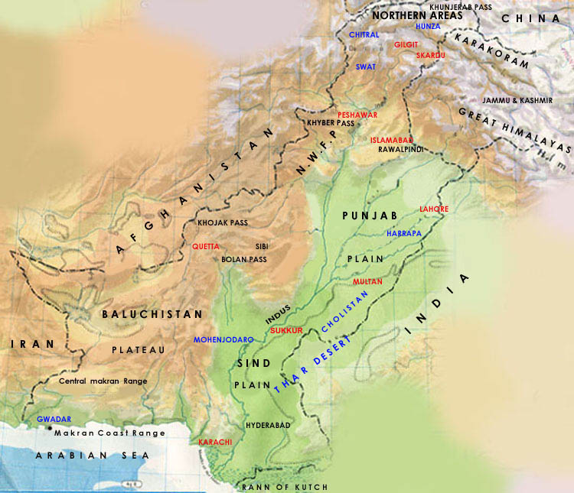
Country Report PAKISTAN Project Steering Committee Meeting Prevention of Transmission of HIV among Drug users in SAARC Countries-(Project H-13) 17 May 2012, Colombo, Srilanka

Slide 4
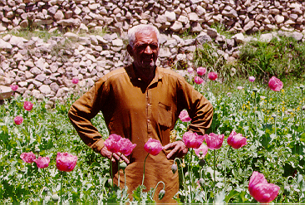
Drug Cultivation & Production
Declared poppy free country-2001
In 2010, following drug seizures were carried out Heroin- 2,974 kg Cannabis- 161,323 kg Opium- 15, 004 Kg

Slide 5
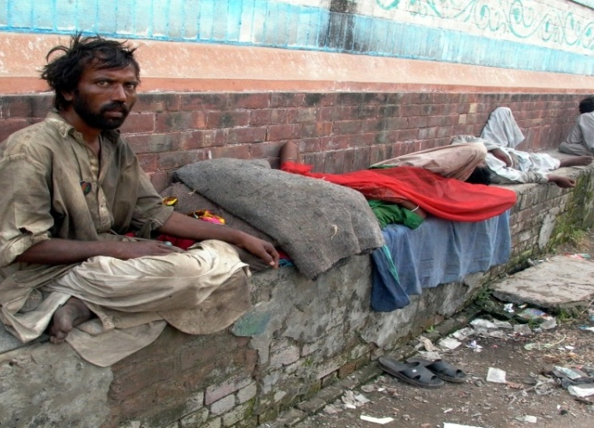
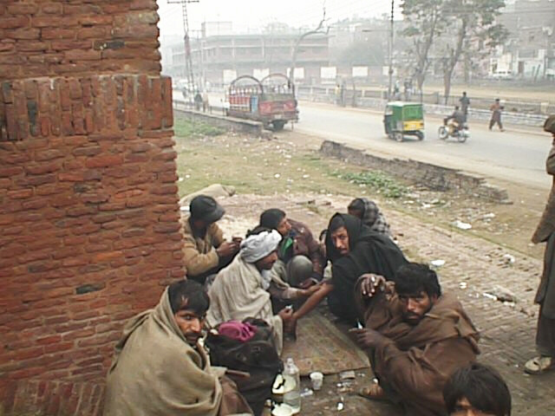
Drug Abuse Problem
Pakistan is the primary transit country for opiates produced in Afghanistan
Opiate abuse is a serious problem
Estimated 625,000 opioid users
Estimated 125,000 injecting drug users
Common drugs of abuse: - Cannabis - Psychotropic Heroin

Slide 6
Drug of Choice
Charas (cannabis) is the most commonly used substance;
Sedatives and Tranquilisers;
Heroin;
Opium;
Injecting drug use;
Solvent Abuse Among Street Children;
Psychotropic

Slide 7
Demographics
Age group: mean age is 35.5 years
Marital Status:more than half of drug users, were married
Living Status; up to 80% of drug users in KPK & Punjab are living with families or friends. In Sindh & Baluchistan up to 30% are living on the streets
Educational: 38 percent had no education, 25 percent had primary and one third had up to high school education
Source of Income: 39 percent are doing casual work

Slide 8
Initiation of Drug Use
.
Average age of initiation of drug use is 18 years
Majority of drug users interviewed had used Charas (Cannabis) as the first substance in their lifetime.

Slide 9
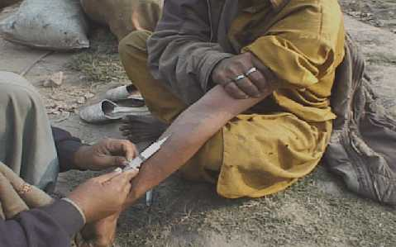
Drugs use for Injections
.
Heroin (49 percent)
Benzodiazepines(36 percent).
Injecting a combination of one or more of these substances with other drugs such as antihistamines.

Slide 10
High Risk Practices
Sharing of Needles: Sind, Baluchistan (80 percent or more); Punjab (70 percent)
Sexual behaviours while around 4 percent mentioned that their regular sex partners were also HIV infected. less than half of these drug users had never used a condom
Up to 20% sold blood

Slide 11
Prevalence of HIV Among IDUs HIV Second Generation Surveillance Round IV- 2011
Overall Prevalence of HIV among IDUs 27%
Faisalabad 52% Karachi 42.2% Gujrat 46.2% Lahore 30% Peshawar 20% Turbat 21%
Pakistan declared as Concentrated HIV Epidemic (among IDUs) Country

Slide 12
Coverage of IDUs
Current coverage is 15,000 IDUs (12%)
To reach 80% of the coverage of IDUs following steps to be taken: Government resources 45,000 IDUs (36%) One UN initiative 10,000 IDUs (8%) International donors & GFATM 28,000 IDUs ( 23%)
Initiate oral substitution treatment programme

Slide 13
Achievements under H-13 Project
Rapid assessments and response analysis (RSRA): 2nd Round 2010
National advocacy strategy developed and disseminated -February 2010
A photo documentary reproduced and disseminated at National & International level
Mid Term Review of the project was carried out. –2010
Intervention toolkits for ‘Positive Living’ translated and disseminated-2010
A qualitative study entitled “social & economic impact of drug use on families’ was conducted – 2010
Training of implementing partners

Slide 14
Achievements under H-13 Project
Oral Substitution Treatment (OST) Program
Advocacy for policy makers, media, religious scholars, proffessionals
Study tours were organised for policy makers and professionals to the regional countries e.g. India, Iran, Uzbekistan
National consultative workshop was organised for policy makers and professionals. Experts from Iran participated
Development of technical documents National protocols Standard Operating Procedures (SOP)
Establishment of steering & technical committees

Slide 15
Achievements under H-13 Project
Activities | 2008 | 2009 | 2010 | 2011 | Total
Peer Led Intervention
Male IDUs Reached | 4,983 | 11,354 | 5,828 | 5,889 | 27,700
Female IDUs Reached | 10 | 32 | 5 | 10 | 57
RSP IDUs Reached | 176 | 806 | 253 | 233 | 1,468
Male DUs Reached | 3,756 | 10,657 | 4,225 | 5,654 | 24,292
Female DUs Reached | 36 | 46 | 23 | 49 | 159
RSP DUs Reached | 165 | 298 | 571 | 335 | 1,369
Detoxification | 845 | 956 | 1,289 | 1,300 | 4,390
Referrals
VCT | 3,245 | 1,973 | 2,137 | 3,268 | 10,623
ART | 56 | 23 | 48 | 37 | 164
STI | 981 | 1,953 | 653 | 1,041 | 4,628

Slide 16
Achievements under H-13 Project
Activities | 2008 | 2009 | 2010 | 2011 | Total
Abscess Management | 1,861 | 3,270 | 3,012 | 2,095 | 10,238
Safe Injecting practices session | 4,305 | 6,832 | 4,321 | 4,536 | 19,985
Condom Demonstration sessions | 1,122 | 1,029 | 986 | 1,248 | 4,385
Sessions with women | 1,964 | 656 | 367 | 2,407 | 5,034
Over dose Management | 78 | 102 | 286 | 62 | 528
Advocacy Meetings | 53 | 48 | 91 | 63 | 255
Community Sensitization Programmes | 41 | 83 | 49 | 62 | 235

Slide 17
How has the project been catalytic in the drug use/HIV national response/s
Advocacy for Oral Substitution
Interventions for spouses of IDUs & DUs- Increased capacity of implementing partners
The project supported HIV prevention services where no such services are available- Quetta Baluchistan
Learning & sharing experience with other regional interventions- trainings, study tours ,data management
Development of resource materials & researches
Capacity building of implementers

Slide 18
Lessons Learnt
Success: Service delivery packages for injecting drug users are well established
Challenges: Low coverage Quality of services Absence of comprehensive services Monitoring & Evaluation
Gaps: Shortage of technically qualified professionals Limited knowledge of policy makers Limited capacity for scaling-up

Slide 19
The Way Forward
Continuation of regional programmes
Strengthening regional cooperation through knowledge and experience sharing
Targeted comprehensive interventions for most at risk populations; basic programs with high coverage
Closely link prevention to treatment.
Regular monitoring of epidemic progression through surveillance
Advocacy for HIV prevention and treatment among opinion leaders (politicians, senior public officials, religious or community leaders, educationists etc);
Review legislations which are barrier in implementing comprehensive harm reduction services and for the rights of drug users

Slide 20
This Child and many others who come into this world need our support to live long and healthy life.

Slide 21
“Health is the greatest gift, contentment the greatest wealth, faithfulness the best relationship”.(Buddha)
Thank you

