Slide 1
Regional Workshop/Conference
to Fast-tracking the Implementation of UNCAC
Vision – “To promote the spirit of zero tolerance against corruption and encourage regional cooperation in the prevention and combating of corruption.”

Slide 2
Overview
Presented by:
Sheryl Steckler, International expert on Whistleblower Protection (UNODC Consultant/PICS)
&
Constanze von Soehnen, Crime Prevention and Criminal Justice Officer (UNODC)

Slide 3
Overview
Session 1: Background & Methodology
Session 2: Current Legislation and Institutional Frameworks
Session 3: Discussion of current status and key considerations for implementing an effective Whistleblower Program
Session 4: Presentation by Civil Society Organisations

Slide 4
Overview
Session 5: Discussion of Additional/Enhanced Legislation & Impacts
(Group Discussion)
Session 6: Assignment of Responsibilities - Monitoring & Guidance on Implementation (Group Discussion)
Session 7: Conclusion & Identification of Ideas (Group Discussion)

Slide 5
Sessions
The next two days is designed to be a discussion and working sessions, therefore we are not worried about the agenda times.

Slide 6
Let’s Begin…

Slide 7
Session 1
Overview
(Background, Introduction & Methodology)
&
Highlights of Country assessments
(broken down by countries visited)

Slide 8
Background
Nairobi Regional Workshop

Slide 9
Nairobi Regional Workshop
February 2017 - Fast-tracking the Implementation of UNCAC to build and foster partnerships and create a regional platform to fast track the implementation of the United Nations Convention against Corruption in support of Sustainable Development Goal 16 in Eastern Africa.
9 RECOMMENDATIONS IN SPECIFIC THEMATIC AREAS
WHISTLEBLOWER PROTECTION
Participating delegations recommended a few concrete and practical steps towards strengthening reporting systems and whistleblower protection, with support from the international community, as needed.

Slide 10
Background
Proposed Action #1: Legislation.
Review and revise legislation, as appropriate, where no comprehensive legislation or gaps exist.
Proposed Action #2: Policies and Procedures.
Review relevant national or institutional policies and procedures which facilitate reporting of corruption and other conduct as specified in the relevant legislation.

Slide 11
Background
Proposed Action #3: Awareness Raising.
Undertake sensitization/awareness raising programmes and explore possibilities to cooperate with civil society organizations and other relevant organizations on reporting channels and protection to encourage citizens to report matters of concern such as corruption to agencies who can investigate such cases. Such initiatives should also include unions, lawyers, media etc.

Slide 12
Background
Proposed Action #4: (Legal) Advice.
Consider options to provide independent (legal) advice to persons who consider blowing the whistle and consider ways of cooperating with civil society organizations/paralegals, etc.
Proposed Action #5: Streamlining.
Explore how to include whistleblower reporting systems and protection at a national or institutional level as a core part of relevant strategies and plans (integrity plans, national anti-corruption strategies, etc.) and to monitor their implementation.

Slide 13
Background
Proposed Action #6: Capacity Building (Regional).
Develop a pool of experts in the region that can support management teams in institutions that wish to strengthen their reporting systems and upon request support national level capacity building initiatives.
Proposed Action #7: Legislation and Establishment of Units.
Develop witness protection legislation and witness protection programmes/units.

Slide 14
Background
Proposed Action #8: Capacity Building.
Provide specialist capacity building including for witness protection units.
Proposed Action #9: Regional / International Cooperation.
Develop mechanisms for cooperation, involving exchange or benchmarking of witness protection good practices and on (temporary) relocation of protected witnesses across borders to ensure their safety.

Slide 15
Methodology
This assessment included a Whistle-blower (WB) questionnaire with 52 questions which included, in part, the law, definitions and scope, reporting process, confidentiality, and protection as well as onsite visits to determine the current status of implementation with the following countries:

Slide 16
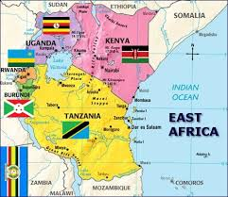
Participated in the Questionnaires
Kenya
Ethiopia
Uganda
Tanzania
Burundi
Questionnaires were also sent to the following:
Djibouti
Rwanda

Slide 17
On-Site Interviews
Kenya
Ethiopia
Uganda
Tanzania
Burundi

Slide 18
Methodology
Kenya - conducted by Louise Portas, UNODC – 3 separate agency meetings with 9 agencies represented:
Anti-Corruption Commission (EACC), Office of Attorney General, Department of Justice, Witness Protection Agency (WPA), and State Ombudsman;
Public Procurement Regulatory Authority (PPRA); and the Public Prosecution (ODPP), Judiciary of Supreme Court and Direction of Criminal Investigations (DCI);
Civil service organisation meeting with Transparency International (TI).

Slide 19
Methodology
Ethiopia - conducted by Tom Caulfield, Procurement Integrity Consulting Services – 1 meeting with 2 agencies represented:
Attorney General and Federal Police Commission;
Civil society organisation (Transparency Ethiopia).

Slide 20
Methodology
Uganda - conducted by Sheryl Steckler, Procurement Integrity Consulting Services, 8 separate meetings:
Inspectorate of Government;
Office of the Director of Public Prosecutions;
Criminal Investigations Directorate;
Directorate of Ethics and Integrity;
Judicial Service Commission;

Slide 21
Methodology
Uganda - conducted by Sheryl Steckler, Procurement Integrity Consulting Services, 8 separate meetings:
Civil society organisation Anti-Corruption Coalition Uganda;
Transparency International Uganda; and
Legal Aid Service Providers Network.

Slide 22
Methodology
Tanzania - conducted by Sheryl Steckler, Procurement Integrity Consulting Services, 6 separate meetings:
Prevention and Combating of Corruption Bureau (PCCB) and National Audit Office;
Attorney General (AG) Division of Public Prosecution (DPP);
Ethics Secretariat;
Financial Intelligence Unit (FIU);

Slide 23
Methodology
Tanzania - conducted by Sheryl Steckler, Procurement Integrity Consulting Services, 6 separate meetings:
Civil society organization - Tanzania Private Sector Foundation; and
The Foundation for Civil Society.

Slide 24
Methodology
Burundi - conducted by Louise Portas, UNODC – 1 agency meeting with 3 agencies represented:
General Prosecution Office;
Anti-Corruption Prosecution Office; and
Legislative Department of the Ministry of Justice

Slide 25
Deliverables
This presentation represents an analysis of the legislation protecting reporting persons in several Eastern African Countries with a focus on the implementation in practice in order to develop proposals how to strengthen protection considering the framework conditions in the given countries.

Slide 26
Session 2
Institutional and Legal Framework
(broken down by country visited)
Discussion of commonalities and differences to identify measures that could further strengthen whistleblower protection in the region.

Slide 27
OPEN DIALOGUE
PLEASE CONTRIBUTE IN YOUR RESPECTIVE COUNTRIES

Slide 28
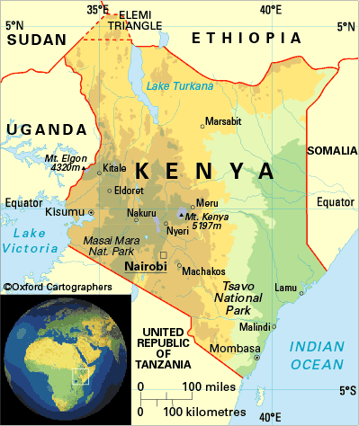
Session 2
Kenya
A Whistle-blowing protection (WB) bill is under adoption. It was developed in 2016. According to statements, it should have been already a law, but because of elections issues, the process has been delayed.
Currently private and public institutions are encouraged to develop whistleblowing policies at internal level. At present, the bill in place is going to make it mandatory.
There were mixed views on whether a reporting person must ask for anonymity or whether they automatically are considered a reporting person.

Slide 29
Session 2
Kenya
It was stated that they can have the laws, but if they do not have the adequate resources to put into place, their law will be useless.
Witness Protection Agency (WPA) might not have enough resources to protect the witness and therefore, witnesses can be afraid to report because as with no resources they are at risk to be discovered.
Currently, Kenya utilizes the Bribery Act. The WB Bill enlarges the scope to civil and administrative. Public Procurement Regulatory Authority (PPRA) handles administrative investigations and are able to keep the identification of the person confidential. The Kenya revenue authority has a policy on whistle-blowing and they can get a percentage as an award.

Slide 30
Session 2
Kenya
In the judiciary, there is an ombudsman who can receive information only for issues with regard to someone from the judiciary. There is no protection if a person who reports suspected criminal conduct or corruption if they raise their concern internally with their employer (such as a supervisor or compliance officer) and gets victimized. Only criminal crimes are protected disclosures.
The 2006 Witness Protection Act established the Witness Protection Program with the mandate to protect the witnesses. Witness must have agreed to cooperate with law enforcement agency. They also need to have recorded a statement.

Slide 31
Session 2
Kenya
There is an integrated public complaints referral mechanism made up of six (6) institutions together that have Memorandums of Understanding (MoUs). Those six are:
EACC
Commission on Administrative justice (CAG)
Kenya National commission on Human Rights (KNCHR)
National coercion and integration commission – coexistence of communities (tribes) in Kenya
TI
National anti-corruption campaign steering committee
Any of these institutions can receive a complaint from public on any topic. The institution who receives a complaint is obliged to refer to the other online to the relevant commission as part of the MoU.

Slide 32
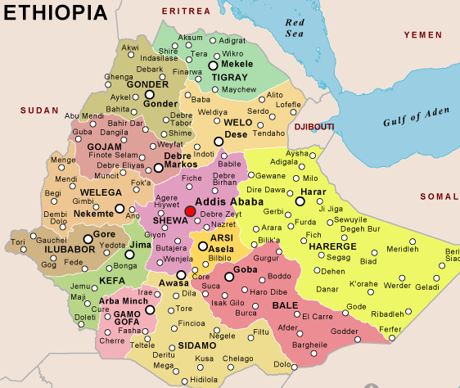
Session 2
Ethiopia
The WB proclamation 669 is all related to the protection afforded to a person that reports information related to a criminal violation. The Federal Attorney General’s (FAG) office determines if a person will get protection under the 669 criteria.
The FAG can tell an organization to hire the person back, however, this was described as an informal process for administrative concerns and not covered under 669.
If the person reporting the same information is from the public (not government) and the information has a “significant public interest,” they could provide the same protection of 669.

Slide 33
Session 2
Ethiopia
The legislation also include protections for subcontractors. Staff stated that they are less interested in who is reporting, but is it a crime and does it have significant public interest.
The legislation specifically states what retaliatory actions against a reporting person are prohibited and only assess awarding protection regarding person or property based on risk believed by the FAG. In practice the anti-corruption may send a letter to the employer but that is not within the requirements of the law. Because of the changes in 2016 the anti-corruption commission lost their authority.

Slide 34
Session 2
Ethiopia
Any person reporting criminal allegations regardless of public or private is protected by law. Same includes reporting by witnesses of criminal law. The type of protection given is for protected physical property/life relocations, escorting, witness, etc. How that protection is provided is not organized and not administered from single unit to ensure uniformity. In essence, there needs to be a violation of the law, and then protection can be afforded when the reporting involves gross mismanagement if it can be linked, in one way or the other, to a violation of a crime.

Slide 35
Session 2
Ethiopia
The law in Ethiopia does not consider the motivation/conduct of the worker/employee in raising their concern.
The Inspectorate General of Government (IGG) indicated that when a person reports they were fired for reporting, the IGG may take the opportunity to write a letter to the agency to which the reporter was fired and have him/her reinstated. This is an informal process not documented and as such there is no consistency of when this is done or by whom.
With respect to confidentiality, Article 4 lists types of protection methods. Under Article 669, there are 24 that have conditions and exceptions. Because all of these cases are criminal, the court and filing would be no different than any other criminal investigation.

Slide 36
Session 2
Ethiopia
There is a documented process from beginning to end for intake of allegations. It is handled like any other criminal case. There are no timelines set for WB cases. The law allows for the WB to be informed of the status of the case (on-going), but not the specific details. The results of the investigation are released to the public and/or media and there are sanctions for breach of WB identity. If WB is granted, an investigation is always conducted (Crime Code 397) because it is criminal.
Procedures to get compensation back do exist, however not because of WB, it is based more due to a wrongful filing issue.

Slide 37
Session 2
Ethiopia
Under Criminal Code Article 44, there are sanctions against those who retaliate against a WB. The sanctions are fines and/or “simple prison” for three years. It is difficult to protect in an administrative case, however Article 4 would be used or tried to be used to enforce.
There is legal advice not representation.

Slide 38
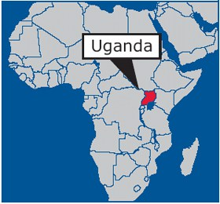
Session 2
Uganda
The Whistleblowers Protection Act, 2010 provides for the procedures by which individuals in both the private and public sector may in the public interest disclose information that relates to irregular, illegal or corrupt practices; to provide for the protection against victimisation of persons who make disclosures; and to provide for related matters.

Slide 39
Session 2
Uganda
The Act includes: Section 2. Disclosure of impropriety.
“Disclosure” means any declaration of information made by a whistleblower with regard to the conduct of one or more persons where the whistleblower has reason to believe that the information given shows or tends to show one or more of the following— (a) that a criminal offence or other unlawful act has been committed, is being committed or is likely to be committed; (b) that a miscarriage of justice has occurred, is occurring or is likely to occur; (c) that a person has failed, is failing or is likely to fail to comply with any legal obligation to which that person is subject; (d) that any matter referred to in paragraphs (a) to (c) has been, is being or is likely to be deliberately concealed.

Slide 40
Session 2
Uganda
Under Section 5 (2) of the Act: When a disclosure of impropriety is made to a person specified in Section 4, the person shall—
(a) make a record of the time and place where the disclosure is made;
(b) give to the whistleblower an acknowledgment in writing of receipt of the disclosure; and
(c) keep the writing in which the disclosure is made confidential, and in safe custody pending investigation of the impropriety.

Slide 41
Session 2
Uganda
Section 4 (3) External disclosures of impropriety may be made to any of the following institutions—
(a) the Inspectorate of Government;
(b) the Directorate of Public Prosecutions;
(c) the Uganda Human Rights Commission;
(d) the Directorate for Ethics and Integrity;
(e) the office of the Resident District Commissioner;
(f) Parliament of Uganda;
(g) the National Environment Management Authority; and
(h) the Uganda Police Force.

Slide 42
Session 2
Uganda
The Section 5 of the Whistleblower Act makes receipt of disclosures compulsory. The Authorities do not have the discretion to grant or reject whistleblower protection. It is mandatory and granted by law once one meets the criteria for being designated a whistleblower.

Slide 43
Session 2
Uganda
Concern was expressed by the IGG’s office regarding WB Act, Section 9 (3): A whistleblower who honestly and reasonably believes that he or she has been victimised as a result of his or her disclosure may make a complaint to either the Inspectorate of Government or the Uganda Human Rights Commission for redress.
(4) Notwithstanding subsection (3) a whistleblower may seek redress for victimisation by bringing a civil action in a court of law.

Slide 44
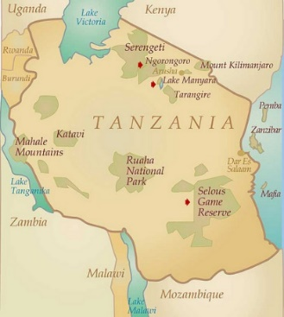
Session 2
Tanzania
Whistleblower and Witness Protection Act (WWPA) of 2015 as well as Combatting of Corruption Act of 2007.
Everyone can be considered under the WB Act.
Protection is provided for those reporting criminal violations. In addition, protection is provided if the person reports an alleged violation of administrative/civil law.

Slide 45
Session 2
Tanzania
Disclosures include: Corruption related crime; All criminal conduct; Gross Mismanagement, Waste of public funds, Gross Misconduct, Abuse of Position; Breaches of regulations/legal obligation including health and safety regulations; the creation of health or safety risks for an individual or several persons; Harm to the environment.
Exceptions: If disclosure which does not affect the interest of sovereignty and integrity of the United Republic of Tanzania, the security of the state and the friendly relations with a foreign state – Section 6 of the Whistleblower and Witness Protection Act of 2015 as well as Section 4 (1) (a) – (e).

Slide 46
Session 2
Tanzania
A person shall be designated as a whistle blower if the disclosure is made in good faith and the information disclosed and an allegation of wrong doing contained in it is substantially valid.
The whistleblower is required to disclose to the competent authority. A whistle blower may disclose a wrong doing to a person who has authority in a locality or a person in whom he has trust and that person shall transmit the disclosure to a competent authority.

Slide 47
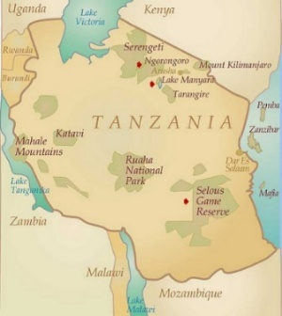
Session 2
Tanzania
Section 3 of the WWPA defines what are competent authorities to which a reporting person may report specific type of allegations.
Section 4 of the WWPA provides for matters which should be reported to the competent authority. Those are where a crime has not been committed or is about to be committed, a person has not complied with the law, the health or safety of the community is endangered, an environment has been degraded, etc.
Section 11 WWPA specifically states what retaliatory actions against a reporting person are prohibited.

Slide 48
Session 2
Tanzania
The law is silent on acting in good faith. There is no clear procedure to determine whether an individual has acted in good faith. The test is left to the competent authority to determine whether there is reasonable cause to believe that the information disclosed is substantially valid.
The identity of the whistle blower or informer is always kept confidential. Further, the details of the informer are kept confidential even when the investigation file is transmitted to investigation machinery.

Slide 49
Session 2
Tanzania
Section 13 of the WWPA provides that law enforcement agencies like PCCB, Police, TISSA, Tanzania Wildlife Conservation Authority and others should reward / compensate Whistleblowers. The law says they should also set a budget for that. But the regulations which provide the procedure are not yet out. But as a matter of courtesy the practice has been that some reward has always been being granted to Whistleblowers so that they help us in attaining out target in investigation and comprehending and arresting the suspects.

Slide 50
Session 2
Tanzania
According to section 51 (3) of the Prevention and Combating of Corruption Act of 2007 any informer who suffers reprisal or retaliation or victimisation or injury or any harm from a person accused of corruption, perpetrators of offences of corruption and their accessories shall be afforded reasonable protection, compensation and assistance by the government upon ascertainment by the Bureau the magnitude of victimisation , injury or harm. See also section 12 &13 WWPA.

Slide 51
Session 2
Tanzania
The law does not prohibit the whistleblower to receive independent legal advice/ guidance before he can make a report provided whatever he reports is done in good faith and he has reasonable grounds to believe that whatever he states is true to the best of his knowledge and belief. Briefly, the regulations on WWPA should be enacted to provide for mechanism on how whistle blower is protected.

Slide 52
Session 2
Tanzania
Section 12 & 13 of the WWPA provides remedies, one being a competent authority to cause the whistle blower or witness to be transferred to another employment or relocated to another place of residence.
According to Section 52 (3) of the Prevention and Combating of Corruption Act of 2007 those who retaliate against a whistle blower if found guilty they are liable to a fine not exceeding five hundred thousand shillings or to imprisonment for a term not exceeding one year or to both. However under the WWPA there is no provision that sanctions those who retaliate against the whistle blower.

Slide 53
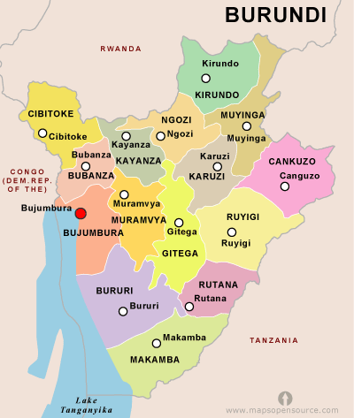
Session 2
Burundi
Summary of questionnaire
There is no specific WB protection law. The law is on the protection of victims, witnesses and other persons which represent a situation of risk (Article 2).
Not only one entity who can receive such alert, possibility to complain to all public official. All public official must declare to the prosecutor all illegal activities that he knows. This is the prosecutor who decide which protective measure must be taken.
If a declaration is done with bad faith, article 14 law anti-corruption law, they can be prosecuted for “false allegations”. Offence of “dénonciations calomnieuse” article 267 CC.

Slide 54
Session 2
Burundi
The law does not provide for a definition of reporting person (dénonciateur). They do not call them WBs and they do not provide for a specific WB status.
Article 12 - anti-corruption provides a definition of the “dénonciateurs” but only applicable in corruption. The anti-corruption law does not criminalize only corruption activates but also traffic of influence, illicit enrichment, mismanagement, favouritism, taking illegal advantage, abuse of assets and money laundering.

Slide 55
Session 2
Burundi
Article 12 of the anti-corruption law only use the term “infraction” / Article 3 of the law on protection of victims, witnesses etc. only provide for the term “information”. The authorities can decide than some protective measures must be taken.
Even if the person wants to reveal his ID or refuse protective measures, the authorities, in particular prosecutor, can decide to organise protective measures anyway (i.e. protection of the person at the audience, meeting in another place than the prosecutor’s office).

Slide 56
Session 2
Burundi
Article 12 anti-corruption law: competent authority must take all necessary measures to protect witnesses, victims and “dénonciateurs”. However, no specific provision has been adopted to protect reporting persons in their employment environment.
Article 3 - If someone has been fired, the supervisor of the person who fired the employee will open an investigation. If investigation is not a success, appeal to General Inspection of Labour (Inspection Générale du Travail). Only administrative appeal, not protection. Then Labout Court.

Slide 57
Session 2
Burundi
Obligation in all public administration to put some “suggestions box”, article 38 and 44 of the law against corruption. This is to be applied to private companies and NGOs. But only “suggestion boxes”.
National toll free number.
If they give a special protective status of whistleblower, people will abuse of it and claim that they are protected. Risk that such provision could be manipulated and the employee use it as his advantage.

Slide 58
Session 3
Current Practices and Challenges facing effective implementation of the Whistleblower Act along with Considerations for the future.
(broken down by country visited).

Slide 59
Session 3
Increase the reporting, via the Whistleblower Act, of wrong-doing to ferret out waste, fraud and/or abuse.
To provide the necessary safeguards for protection of a person willing to come forward and report allegations under the WB Act.

Slide 60
Session 3
If a reporting person does not feel the government/private sector can assure protection and seek reward without identity disclosure, the Act is rendered unsuccessful in its purpose.

Slide 61
Is There A Difference?
Issue One
Whistleblower versus Witness Protection

Slide 62
Whistleblower & Witness Protection Programs
Is There A Difference?

Slide 63
Witness Protection
A government program that provides new identities and protection for witnesses who come forward and testify against dangerous targets. English Wiktionary
Criminal

Slide 64
Whistleblower Protection
A person who exposes any kind of information or activity that is deemed illegal, unethical or not correct within an organisation that is either private or public.
Wikipedia
Administrative
Criminal

Slide 65
Purpose of a Whistleblower Program
Legislative Intent
To prevent agencies or independent contractors from taking retaliatory action against an employee who reports to an appropriate agency violations of law that create a substantial and specific danger to the public’s health, safety, or welfare.
It is further the intent to prevent agencies or independent contractors from taking retaliatory action against any person who discloses information to an appropriate agency alleging improper use of governmental office, gross waste of funds, or any other abuse or gross neglect of duty on the part of an agency, public officer, or employee.

Slide 66
Purpose of a Whistleblower Program
Prevent Workplace Retaliation
Whistleblower disclosures can save lives as well as billions of taxpayer dollars. They play a critical role in keeping our Government (and private sector) honest, efficient, and accountable.
Recognizing that whistleblowers root out fraud, waste, and abuse, and protect public health and safety, the law should also protect whistleblowers from retaliation.

Slide 67
Prohibited Personnel Practices
Whistleblower protection law also provides legal remedies for employees or job applicants who face retaliation for making protected disclosures of fraud, waste, abuse, mismanagement, or substantial and specific danger to public safety or health.
Specifically, it is a prohibited personnel practice for employers to retaliate against whistleblowers by taking, failing to take, or threatening to take or not to take, a personnel action.

Slide 68
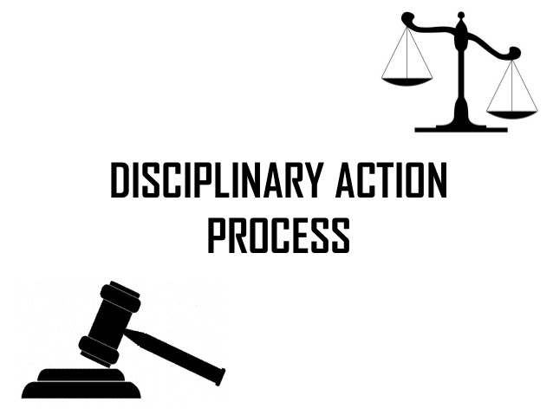
Prohibited Personnel Practices
“Personnel action” means an appointment, promotion, disciplinary action, detail, transfer, reassignment, reinstatement, restoration, or reemployment; a decision concerning performance evaluations, pay, benefits, awards, education, training; or any other significant change in duties, responsibilities, or working conditions.
In addition, the law prohibits retaliation for filing an appeal, complaint, or grievance; helping someone else file or testifying on their behalf; or cooperating with or disclosing information to Authorized/Competent Authority.

Slide 69
Key Elements of Whistleblower Legislation
Protected Disclosures
A “protected disclosure” under a whistleblower protection law should include any disclosure of information that an employee, former employee, or applicant for employment reasonably believes evidences—
Violation of any law, rule, or regulation;
Gross (Significant) mismanagement;
Gross (Significant) waste of funds;
Abuse of authority; or
Substantial and specific danger to public health or safety.

Slide 70
Purpose of a Witness Protection Program
To encourage witnesses to crimes to provide their testimonies without fear of retribution. In many cases, witnesses receive threats against themselves and their family members in an effort to scare them out of testifying against former associates.
Often, participation in the program is a way for individuals facing their own criminal charges to receive reduced sentences or even have their charges dropped entirely. Through the Witness Protection Program, an individual and his/her family can receive new identities and be relocated to a new city to live without fear of harm after an investigation is over.

Slide 71
OPEN DISCUSSION
DIFFERENCE BETWEEN WHISTLEBLOWER AND WITNESS PROTECTION…..

Slide 72
Purpose of a Witness Protection Program
In most circumstances, participation in this program is for life, however, it can be limited if it is deemed the participant is no longer requires it. Participation in the program can be renewed, though, if necessary.
Individuals who participate in this program are taken from their homes and relocated to new cities, given new identities, and provided with stipends until they secure new jobs and can support themselves. Along with new identities, participants receive new legal documentation such as social security cards and birth certificates. Medical and school records are also often changed to align with participants’ new identities.

Slide 73
Consideration
There is a distinction between Whistleblower and Witness Protection. Traditionally, whistleblower is utilized as an administrative remedy for those in fear of retaliation such as demotion or losing their job and/or contract with the government. Witness Protection is utilized to physically protect those individuals reporting criminal allegations, fraud and/or corruption.
A comprehensive understanding of the differences between the two programs is needed to ensure they are properly implemented and the goal to provide the necessary safeguards depending on circumstances are met.

Slide 74
Tone at the Top
Issue Two
Environment - Culture
The tone at the top is set by all levels of management and has a trickle-down effect on all employees within the workplace.
If the tone set by management upholds honesty, integrity and ethics, employees are more likely to uphold those same values.

Slide 75
Critical Ingredient
The tone at the top sets an organization’s guiding values and ethical climate. Properly fed and nurtured, it is the foundation upon which the culture of an enterprise is built. Ultimately, it is the glue that holds an organization together.

Slide 76
OPEN DISCUSSION
WHO CAN PROMOTE THE TONE IN YOUR ORGANISATION?

Slide 77
Consideration
What is Your Readiness?
Enhance the ability of implementing an effective whistleblowing program by conducting an assessment of the Tone at the Top. This assessment is critical to ensure a commitment is there and “the will” to put the appropriate internal controls and resources in place.

Slide 78
Structure, Consistency & Coordination
Issue Three
Current Status
There is no standard application of practice for the whistleblower program nor is there any structure in place on how to implement this legislation.

Slide 79
Structure, Consistency & Coordination
Uganda
Whistleblower is not “designated”. All complainants are considered a whistleblower unless there is lack of information, no direct information (speculation), etc. It is a judgement call. They follow the law and its requirements. If met, individual is considered a WB.

Slide 80
Structure, Consistency & Coordination
Tanzania
There is no one in charge of granting WB. Having a single entity (coordinator) for consistency and avoid duplication was discussed.
There is no proper channel of who owns the responsibility if the person will be victimized.
There is no percentage for reward. Further, there is no set aside fund for rewarding WBs. A fund exist to reward under the Prevention and Combating of Corruption Bureau (PCCB) Act. Police and PCCB have informants with money they can pay. This is only for citizens not employees.

Slide 81
Structure, Consistency & Coordination
Whistleblower protection cannot be used as a temptation for investigators and prosecutors in obtaining information and then withdraw the protection when information is no longer worthy.
It also should not be inconsistently applied as to who is given whistleblower protection (keeping in mind for job retaliation). If left to the opinion and minds of multiple individuals, there will be the tendency to “shop” around from one agency to another.

Slide 82
Structure, Consistency & Coordination
Central Coordinator
There is no universal method to determine whether a reporting person falls within the definition of a whistle-blower nor a written process on how to document a WB designation.

Slide 83
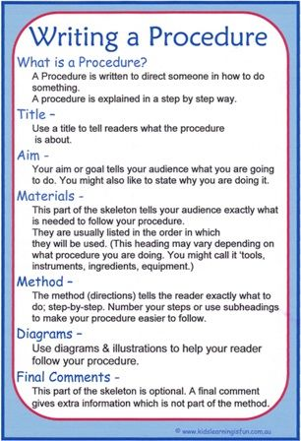
OPEN DISCUSSION
Structure, Consistency & Coordination

Slide 84
Considerations
A WB designation form should be used by each agency whom reviews allegations to ensure the law is applied consistently in its use when making such determination.
Consideration should also be given for a central point of contact within the organization who can make the determination of whether the complaint rises to the level of whistleblower and grants said designation and refers to appropriate authority (where applicable). For example, in Uganda, Under Article 230 (2) of the Constitution and Section 14 (6) of the Inspectorate of Government Act, 2002, the Inspector General of Government is empowered to make any directives deemed necessary during the course of or as a consequence of the findings in an investigation.

Slide 85
Written Procedures with Timelines
Issue Four
There does not appear to be any written standards or guidance/procedures on how to determine whether a reporting individual is eligible under the Act to be a WB. This can lead to subjective analysis or no analysis at all, thereby not providing the appropriate protection, where warranted.
Further, if the investigation is not subject to time standards, cases can linger for years on end with evidence disappearing or no longer available. Without a formalized process, guidance on how to apply the WB Act is lacking.

Slide 86
OPEN DISCUSSION
SETTING TIMELINES & DOCUMENTING EXCEPTIONS

Slide 87
Considerations
Policy & Timelines
In order to ensure the integrity of a WB process, standardized procedures should be written to include timelines with due dates from onset of receiving a complaint through the investigative conclusion, and all involved must be trained to ensure a consistent approach is used. This procedure could be placed in the Regulation or a separate guidance document.
Forms should be drafted which include: a WB Complaint Form; a WB determination form; a Letter of Determination decision to potential WBs; and a WB waiver for those instances where the WB grants release of his/her name to refer to the appropriate agency.

Slide 88
Method to Report
Issue Five
Toll Free Hotlines
Not all agencies responsible for receiving whistleblower complaints have an toll free number for reporting persons to call. This can discourage a person from reporting wrongdoing as their alternative is to come in person or write.
It is noted, some agencies had multiple free hotlines where the need may not be there.

Slide 89
Consideration
Consider conducting an analysis of all toll free hotline numbers and see if there are available lines for agencies that are required by statutes to take on this responsibility.
*Keeping in mind, anonymity is available but not for WB designation.

Slide 90
Maintenance of Records/Evidence
Issue Six
There are challenges in obtaining information from one government office to another. In addition, there appears to be issues involving evidence disappearing when going from one government entity to another.
Additional issues expressed was the length of time an investigation is completed and/or goes to court. Evidence is either getting lost or destroyed.
It was also revealed that other than an administrative tax code (no penalty – receive a bill), there are no laws or regulations ensuring contractors are maintaining records for a period of time during and after contract term.

Slide 91
Considerations
Records are critical to any investigation both from proving innocence to guilt. Safeguards should be in place to ensure records are maintained. Further, any company doing business with the government from the private sector should be included in record retention legislation.
For those that have a requirement to maintain records, a logging system for accountability of records should be established.

Slide 92
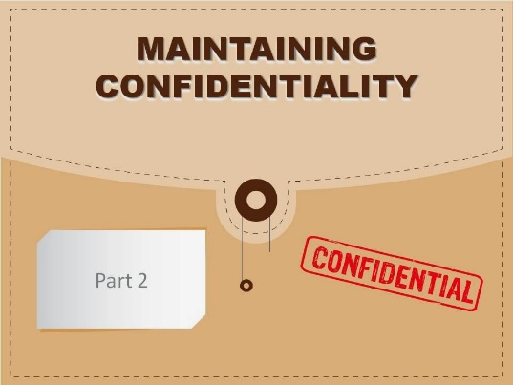
Confidentiality
Issue Seven
Protecting the identity of a WB is paramount to the success of this Act. Safeguards must be in place to ensure the integrity of the process and investigation.
There was concern expressed in at least one country, that information and identities of their cases would be discussed amongst their organisation and to the public information officer. As a result, information is going to the media.

Slide 93
Considerations
Due to the lack of awareness of what, by law, should be kept confidential and not disclosed during an open investigation, most importantly the identity of the WB, training should be conducted within each entity involved in handling these cases.

Slide 94
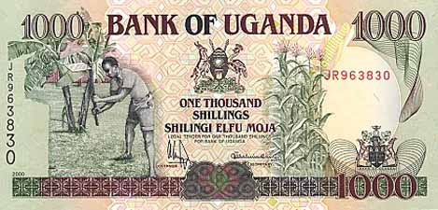
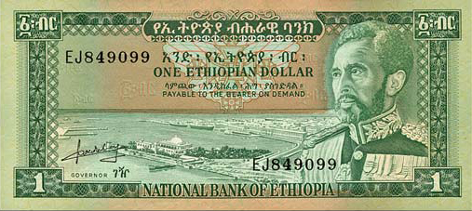
Resources
Issue Eight
Increased reporting should be balanced with appropriate funding to investigate WB complaints.
In order to enhance success of the WB program, each country should address adequate staffing along with expectations of timely results.

Slide 95
Resources
Uganda
On-site visit statements indicated the problem is the effectiveness and implementation of the WB law. They ranked the Law itself at 99%, but the effective implementation was at 54%. They felt many factors contributed to this. Top three were:
Evidence
Facilitation (Resources) – Not enough funds to do the job. They need to be empowered with personnel, equipment, training and funding.
Courage and Practices – used example of employee theft in accounting office and harming the poor. Very little was done to employee.

Slide 96
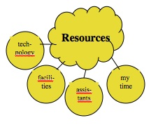
OPEN DISCUSSION
WHAT ARE YOUR RESOURCE CONCERNS WITH IMPLEMENTING THE WHISTLEBLOWER ACT?

Slide 97
Considerations
It was discussed in Uganda that new legislation is being proposed for asset forfeiture. This avenue can provide a funding base for certain investigations.
Consideration should also be given to new legislation which requires Investigative Cost Recoveries are provided to the agency conducting a WB investigation involving financial loss/theft.
*It is noted, this could also have a deterrent factor.

Slide 98
Communication & Training (Internal)
Issue Nine
It was clear throughout the on-site visits that very few members of the government truly understood how to implement an effective WB program to increase reporting and safeguard one’s livelihood. In fact, only one of the seven entities interviewed in one location were even aware that the WB Regulation had been written and issued.
There was much confusion between what is an informant versus a Whistleblower versus someone needing witness protection.
Another agency expressed concerns that investigators are not trained in questions they are prohibited from asking due to the Act.

Slide 99
Communication & Training (Internal)
In addition, as expressed earlier, there are issues with confidentiality of records during open investigations.
One agency was not familiar that there was a reward for a WB reporter.
Overarching most government entities/staff welcomed the suggestion of training. It was noted that one entity was only trained one time approximately four years ago.

Slide 100
Communication & Training (Internal)
Uganda
The Whistleblower Act call for the Directorate of Ethics and Integrity to write the Regulations. The Whistleblowers Protection Regulations were written in 2015. However, it has not been widely published and therefore almost no one knew of its existence. In fact, only one source who was interviewed had knowledge of the Regulation and provided a copy.

Slide 101
Communication & Training (Internal)
Tanzania
We fail to use the Whistleblower Act as the Regulations are not in place. As a matter of practice they normally do not disclose the reporting person’s name or address.
No one knows about the Act. It’s difficult to get the Act, not even on the internet. Most people hear about it and know it exists, but haven't seen it. Only the bill is available not the enacted legislation.
Witness Protection (WP) and Whistleblower (WB) are separate within the Act itself. Section 9 – WB; Section 11 WP. Needs to be better defined in the Regulation as to what is the difference.

Slide 102
OPEN DISCUSSION
INTERNAL
EDUCATION & TRAINING

Slide 103
Considerations
Each member office listed in the WB Act should receive consistent formalized training on the WB law and Regulation, its intent, definitions, process requirements, timelines for each stage of the process, penalties for victimization and reward.
All employees including Senior and mid-level management throughout the government should also receive this training.

Slide 104
Outreach & Education (External)
Issue Ten
The law is good, however, the general consensus both internally and externally was people do not know about the WB Act. Further, they are having a hard time as people don’t read and/or they do not know how and where to report.
There are several Civil Society Organizations that stand ready to assist. They have access to resources to assist in a public awareness strategy. Everything from posters, workshops, talk shows, newspaper ads.

Slide 105
OPEN DISCUSSION
EXTERNAL
OUTREACH

Slide 106
Considerations
Consider utilizing Coalitions and other civil society organisations to assist in their communities for public awareness of the WB Act. It is noted, this should not be started until the structure and protection of a WB is accomplished by the government.
For benchmarking, consider creating a five question survey before and after training to measure people’s knowledge before and after training.
Consider providing a toll free number to those organisations handling WB complaints.

Slide 107
Rewards
Issue Eleven
There is little to no clear understanding of how a WB would receive their reward or who’s responsibility it was to ensure payment was made; particularly without releasing one the WB identity.
There is a challenge once a WB case is proven that they get their payment. Statements indicated there is no budget line-item for paying WBs. Further, there is confusion as to who is responsible to request and ensure the WB gets paid.

Slide 108
OPEN DISCUSSION
REWARDS & CHALLENGES

Slide 109
Consideration
In order to fulfil the requirements under the WB Act which provide for a reward, a WB Fund should be separately established, process for paying rewards should be created, and the fund should be audited for compliance and accountability.
Awareness training of the types of rewards should also be considered both internally and externally.

Slide 110
Court System
Issue Twelve
Although not directly in the scope of the review, repeated issues with the delay in the court system came to the forefront.
The WB program, or for that matter any investigation, cannot linger for years in the court system. It fails the people and will become a deterrent factor in reporting.

Slide 111
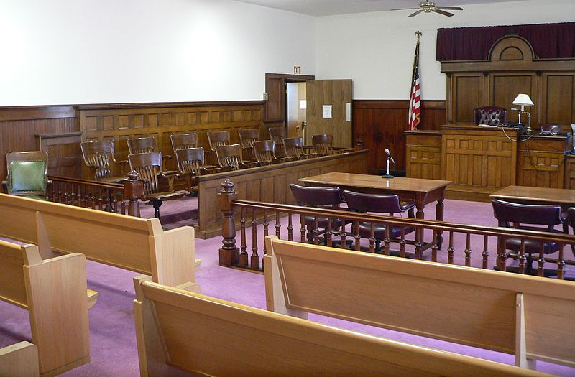
OPEN DISCUSSION
MOVEMENT OF CASES THROUGH THE JUDICIAL SYSTEM

Slide 112
Considerations
Systems exists in other countries such as the United States, where plea agreements are offered to reduce the caseload in the courts and expedite resolution. The benefits are many to include quicker disposition, faster recoveries of money lost and increase victories in wrong-doing.
Suggest future discussions include the judicial system’s role in enhancing the effectiveness and efficiency in implementing the WB Program.

Slide 113
Session 4
External reporting and the role of civil society in receiving and handling whistleblower reports and/or providing advice.
Presentations and input from civil society representatives active in the field of whistleblower protection.

Slide 114
Session 5
Consideration for new and/or revised Whistleblower legislation.
(Group Discussion)

Slide 115
Session 6
Assignment of Responsibilities
to enhance current status
Monitoring the implementation of whistleblowing, whistleblower protection and providing guidance to designated persons or authorities that receive reports.
(Group Discussion)

Slide 116
Session 7
Conclusion & Identification of concrete ideas on how to strengthen the topics discussed in the workshop at the regional, national and institutional level.
(Group Discussion)

Slide 117
QUESTIONS

Slide 118
CONTACT
SHERYL G. STECKLER
President
WhatsApp +18504430807
Sheryl@Procurement-Integrity.net
www.Procurement-Integrity.net
A Woman-Owned Small Business

Slide 119
CONTACT
Photo
CONSTANZE Von Soehnen
UNODC
Crime Prevention and Criminal Justice Officer
WhatsApp +436767406640
Constanze.vonsoehnen@un.org

