Slide 1


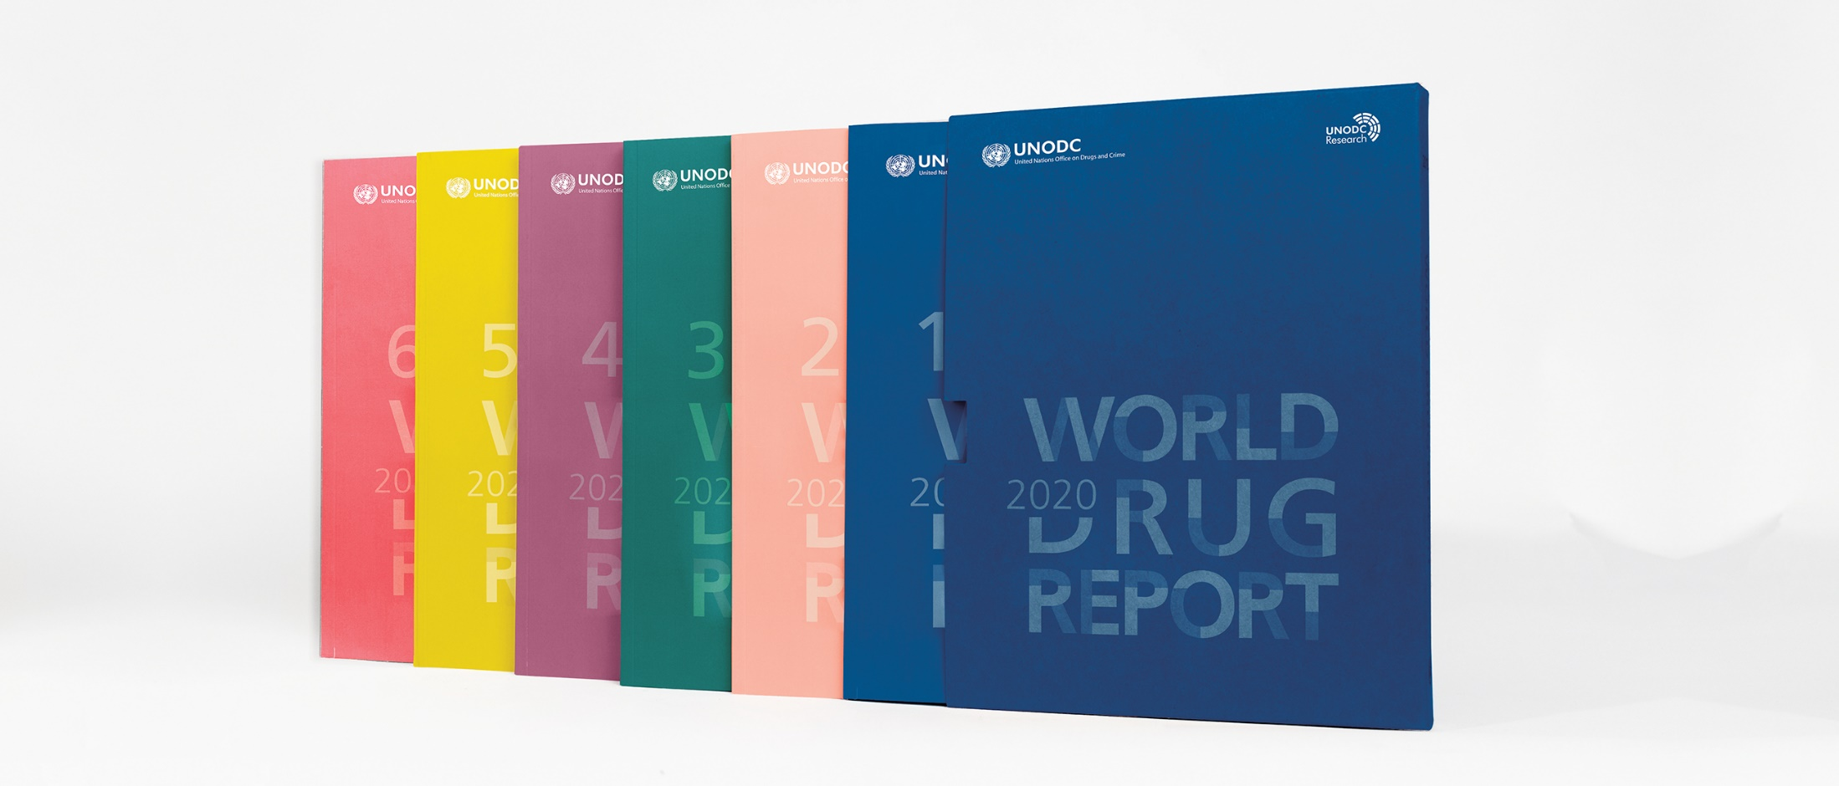
World Drug Report 2020
Vienna, 25 June 2020

Slide 2
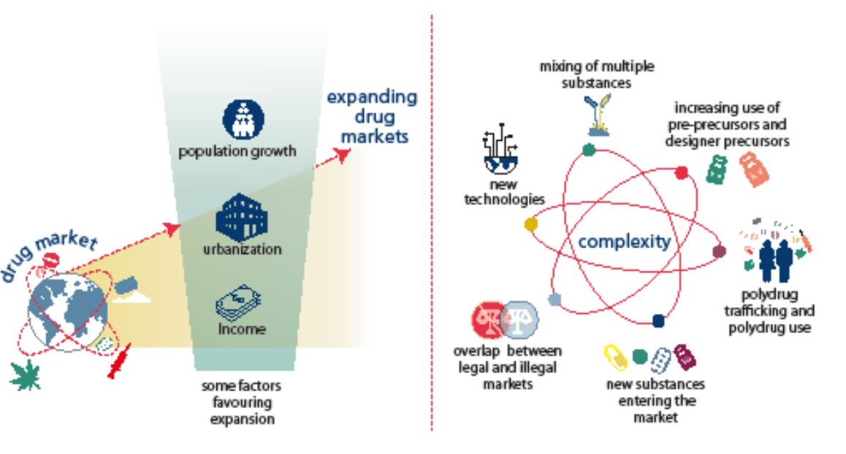
Global drug market: expanding and more complex

Slide 3
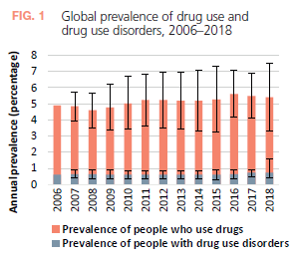
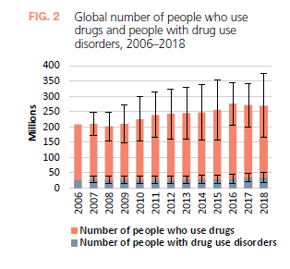
Global drug market: expanding and more complex
drug use has been on the rise - both overall numbers and the proportion of the world’s population
increased far more rapidly in developing countries though more widespread in developed countries
transition to drug use disorders is more prevalent among people with a lower socioeconomic status.

Slide 4
Emergence of substances not under international control stabilized
Potentially harmful opioid new psychoactive substances are on the increase
Use of NPS may become cemented among vulnerable population groups
Regulating new psychoactive substances appears to have a containment effect

Slide 5
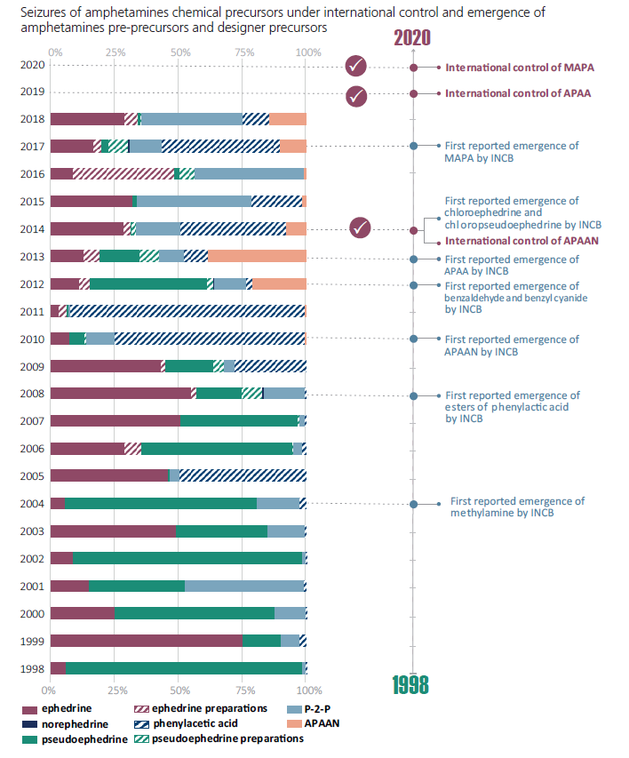
Controls on precursor chemicals force drug manufacturers to innovate

Slide 6
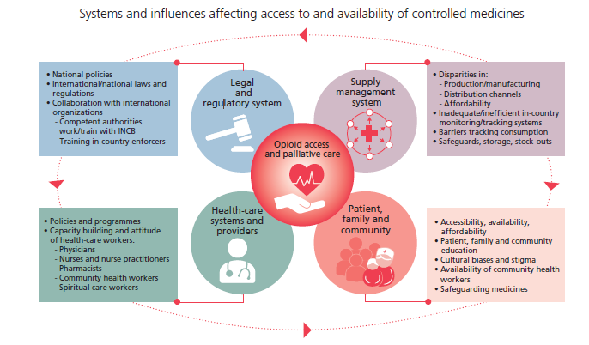
Pharmaceutical opioids for pain management
and palliative care are available mostly in high-income countries

Slide 7
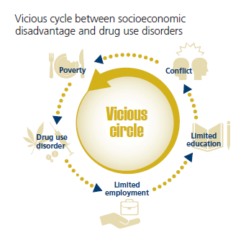
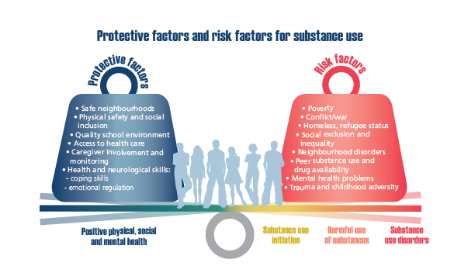
Socio-economic disadvantages: poorer people face a greater risk of drug use disorders

Slide 8
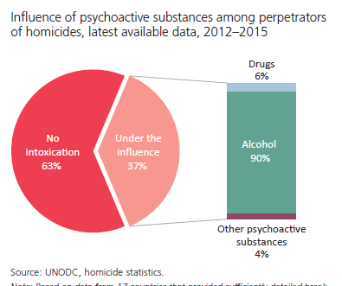
Economic compulsive and psychopharmacological links between psychoactive substances, violence and criminal activity
The systemic link: violence in the context of drug trafficking
The relationship between drugs and violence is complex

Slide 9
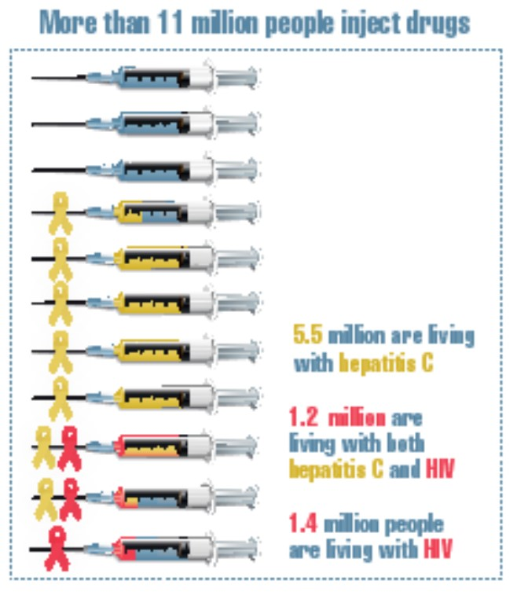
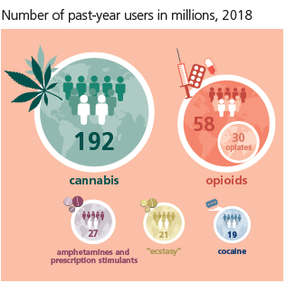
Latest trends: drug use
Cannabis the most used substance
Opioids the most harmful
Simulant use on the increase

Slide 10
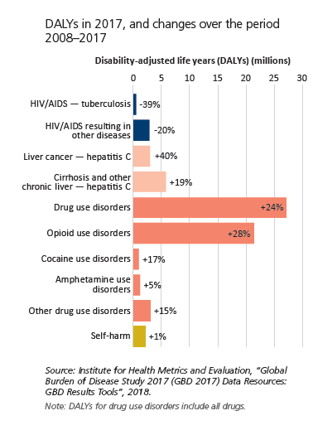
Opioids cause the main harm:
Non-medical use of synthetic opioids fuels public health crises
Non-medical se of opioids account for
66 per cent of 167,00 deaths due to drug use disorders
Half of 42 million years lost due to disability and premature deaths
Fueling opioid crisis in North America, West and Central Africa

Slide 11
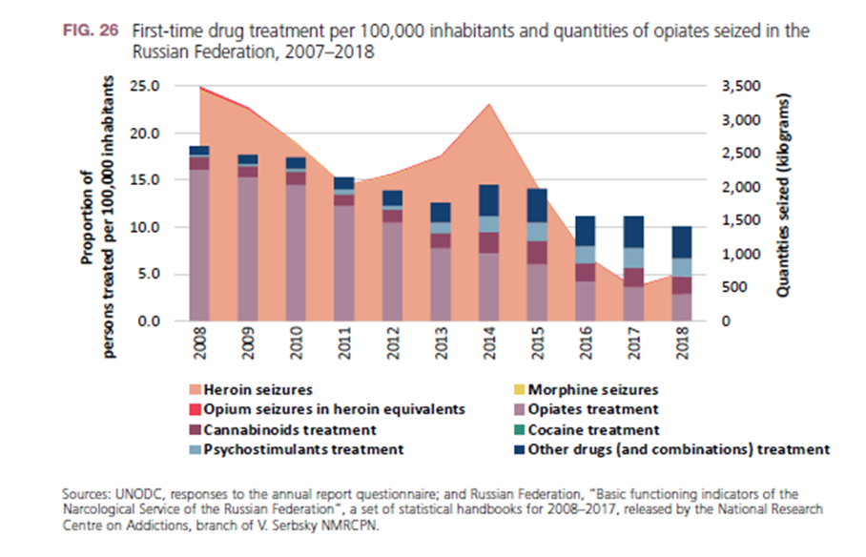
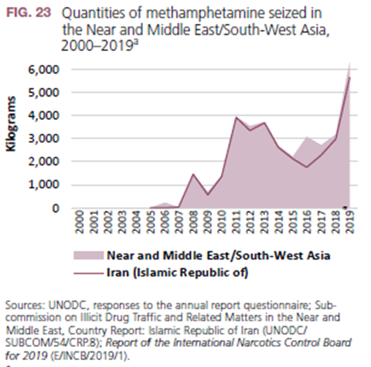
Rapid market changes
Synthetics replace opiates in Central Asia and the Russian Federation
Methamphetamine market grows in Afghanistan and Iraq

Slide 12
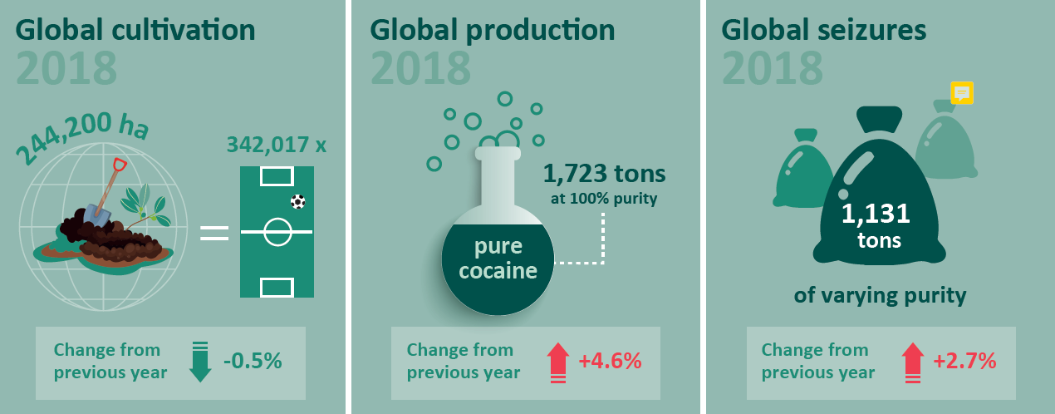
Supply of plant-based drugs still at a
high level despite some decreases:
Cocaine

Slide 13
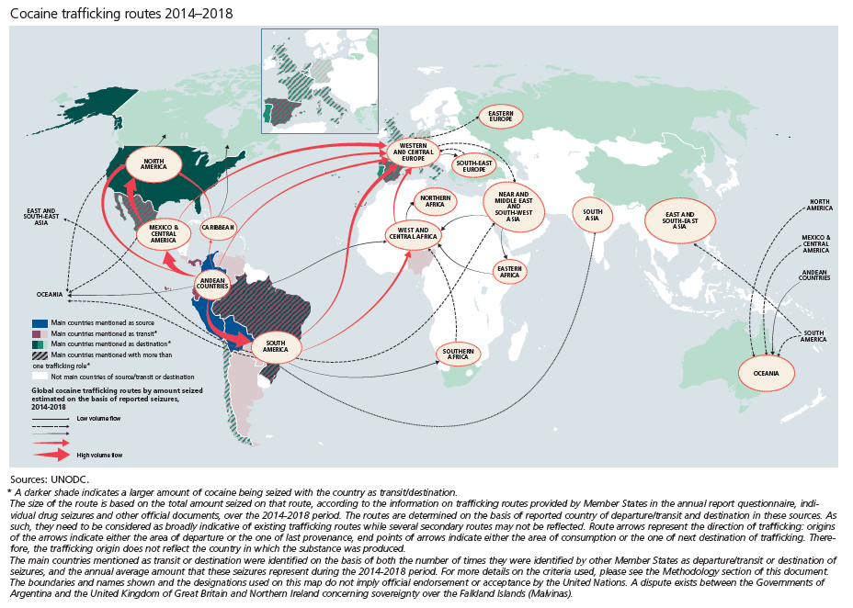
Traffickers show resilience by changing routes – cocaine trafficking routes (2014-2018)

Slide 14
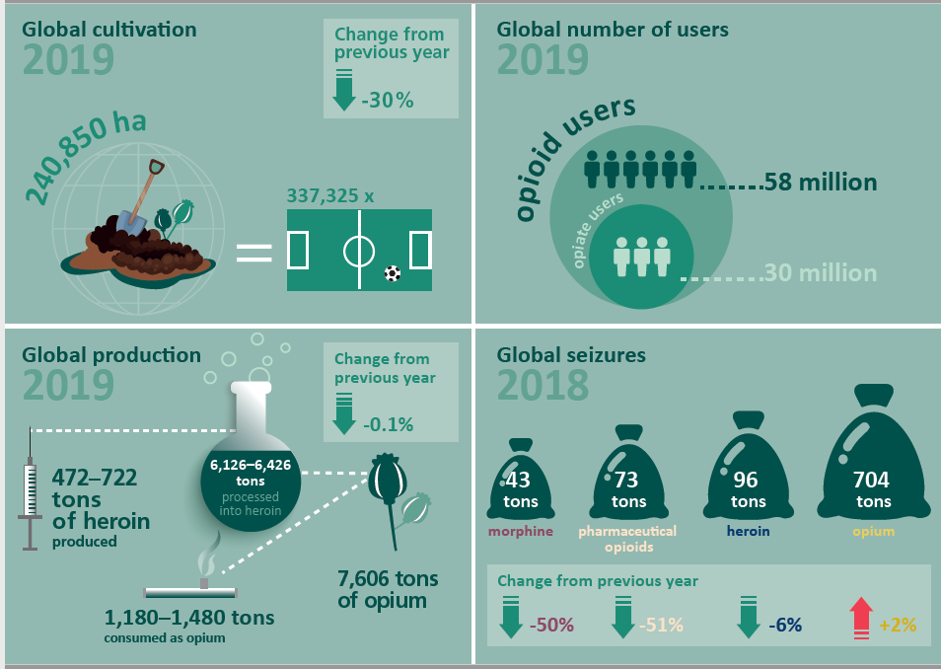
Supply of plant-based drugs still at a
high level: Heroin cultivation and production

Slide 15
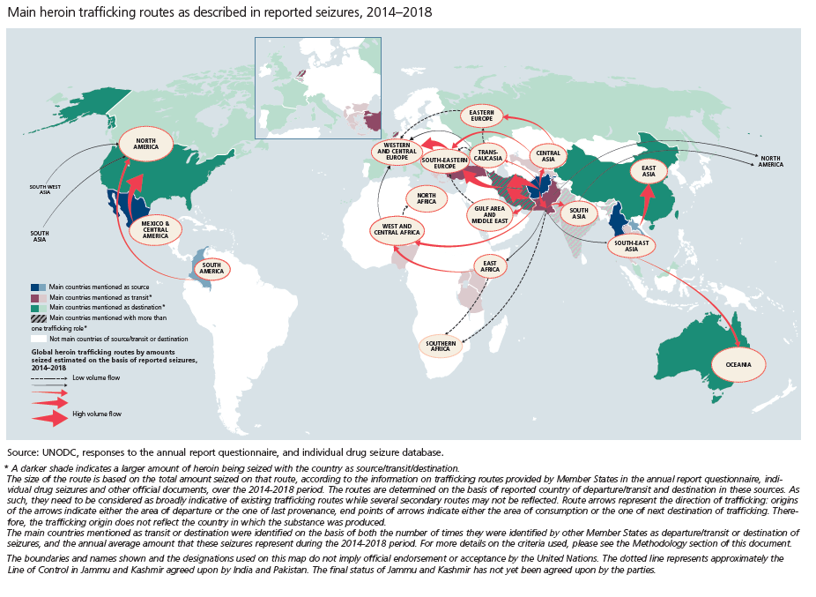
Traffickers show resilience by changing routes - - heroin trafficking trends 2014-18

Slide 16
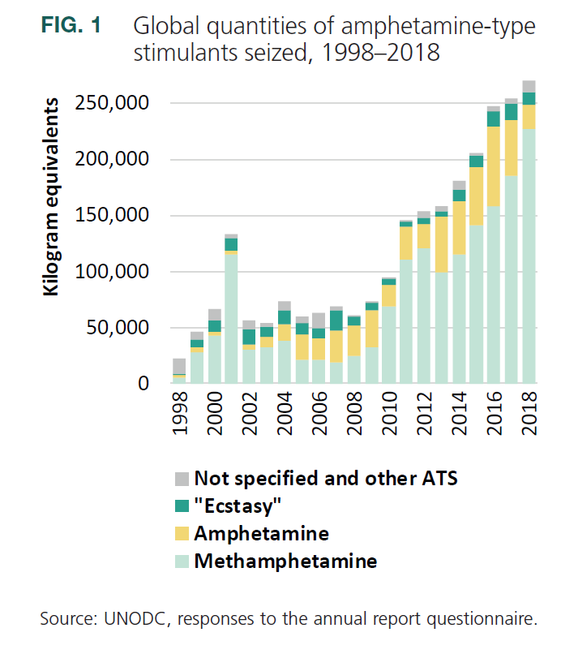
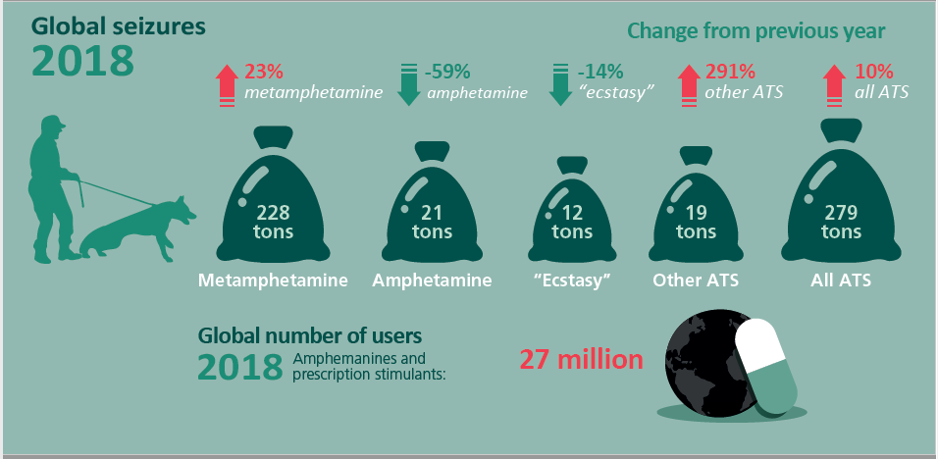
Markets for amphetamine-type stimulants show signs of continued expansion

Slide 17
COVID-19 and the drug supply chain: from production and trafficking to use
Production
Restrictions resulting from the lockdown could hinder the production and sale of opiates in major producing countries
Measures are impeding cocaine production in the short term, but a resurgence is likely in the event of an economic crisis
Reduced trade is limiting the availability of precursors for synthetic drugs in some regions

Slide 18
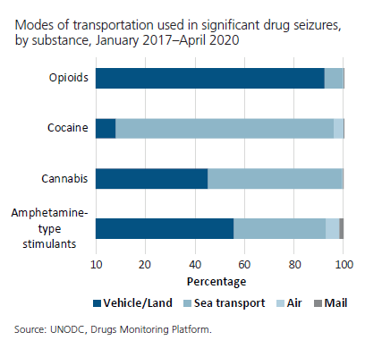
COVID-19 and drug trafficking
Drug trafficking by air is likely to be completely disrupted by the restrictions imposed on air travel
Signs of increased use of maritime routes to traffic heroin to Europe
Border measures appear to be hindering trafficking in opiates
Large shipments of cocaine are still being trafficked but by alternative means
Indications of a reduction in the flow of cocaine is not yet affecting seizures in destination markets
COVID-19 measures are likely to lead to the stockpiling of drugs

Slide 19
COVID-19 and drug use
Drug shortages have been reported and could have negative health consequences for people with drug use disorders
Drug use disorders and regular drug use can lead to complications and mortality if users become infected with COVID-19
Economic difficulties caused by COVID-19 could change drug consumption for the worse

Slide 20
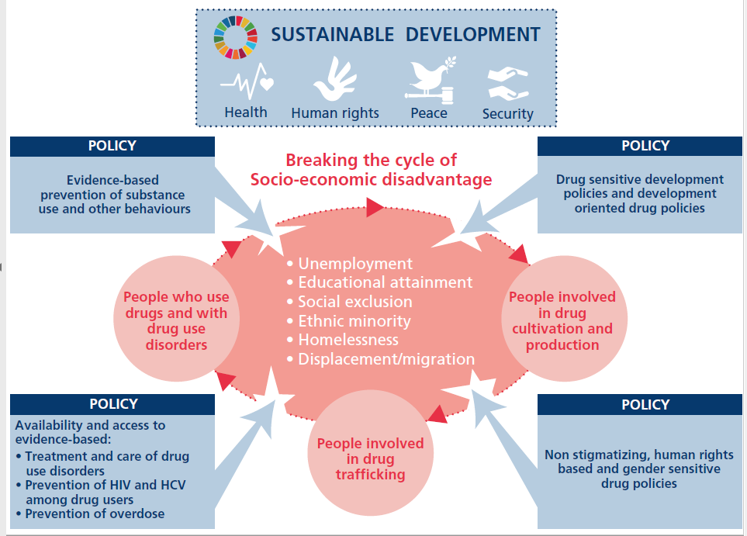
Addressing global drug problem requires drug policy implemented in tandem with broader agenda for sustainable development

