Slide 1
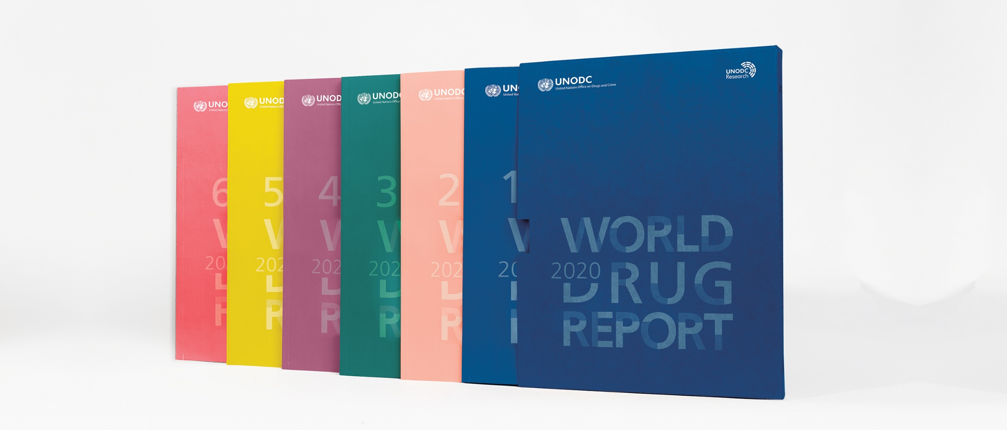
World Drug Report 2020: Developments in jurisdictions with measures regulating non medical use of cannabis

Slide 2
Developments in jurisdictions with measures regulating non medical use of cannabis
As at December 2019, legal provisions allowing non-medicla use of cannabis had been approved in
Canada,
Uruguay and
11 jurisdictions in the United States, including the District of Columbia and the Northern Mariana Islands,
Allow the production and sale of cannabis products for non-medical use. The common feature of the legislation in Canada and in the jurisdictions in the
United States is that most of them allow for-profit industry to produce and sell cannabis products for non-medical use.

Slide 3
Legalization of the non-medical
use of cannabis in Canada
In 2018, the Government of Canada passed the Cannabis Act, which permits the commercial production and sale of cannabis products for non-medical use by people aged 18 and older.
The new legislation and its supporting regulations came into effect on 17 October 2018
The objectives of the current cannabis legislation in Canada are to
keep cannabis away from young people (under 18 years of age),
prevent criminals from profiting from the distribution and sale of cannabis and
safeguard public health and safety by allowing adults (aged 18 and older) legal access to cannabis.

Slide 4
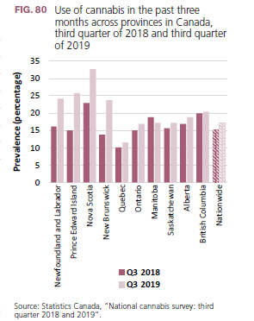
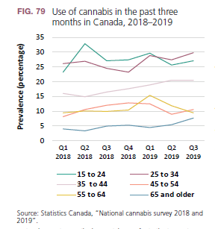
Following an initial increase in
2018, cannabis use appears to have
Stabilized in Canada

Slide 5
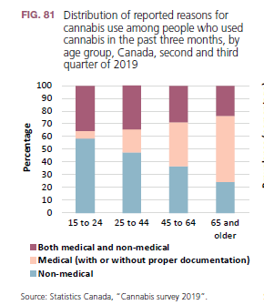
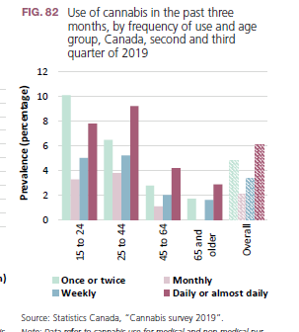
Most young people are using cannabis for non-medical purposes in Canada

Slide 6
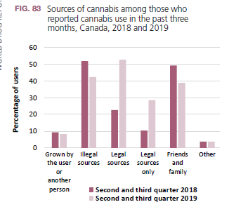
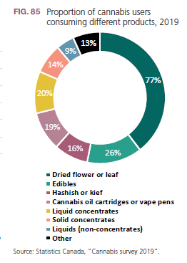
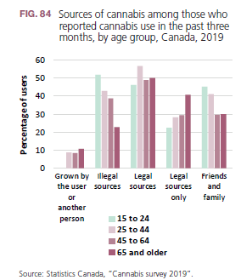
Many cannabis users continue to
purchase cannabis from illegal sources in Canada
Source: Statistics Canada, “Cannabis survey 2018 and 2019

Slide 7
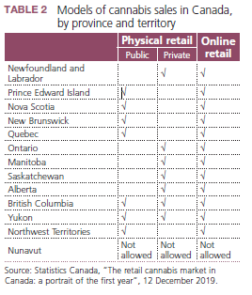
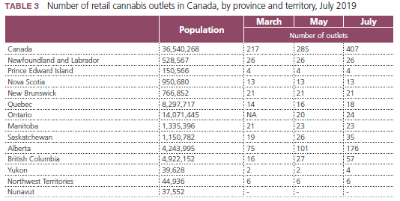
Implementation of cannabis
regulations differs across provinces in Canada
In most provinces, the retail licensing regime is similar
to that regulating the sale of liquor, and cannabis
is sold through licensed retailers (private sector), provincial retail stores and online

Slide 8
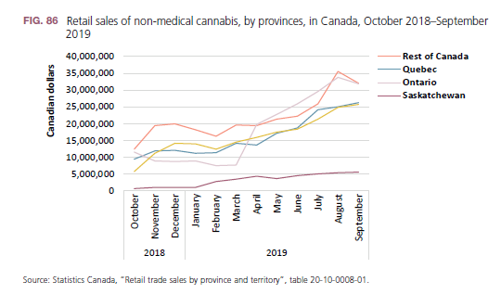
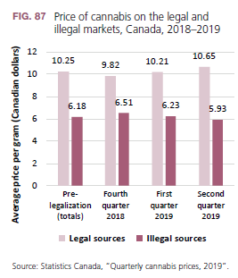
Retail sale of non-medical cannabis in Canada
retail sales of nonmedical cannabis online and in cannabis stores up to September 2019 totalled some 908 million Canadian dollars,334 or an average of Can$24 (approximately $18) per capita.
Prices in illegal market remain low

Slide 9
Large corporations are investing in the
cannabis market in Canada
According to media sources,
In October 2017 Constellation Brands, a major international producer of wine, beer and spirits, invested $4 billion to acquire a 9.9 per cent stake in Canopy Growth, the leading Canadian producer, to develop cannabis-based beverages.
By the end of December 2019, Constellation owned a 35 per cent stake in Canopy.
In December 2018, the tobacco company Altria made a $1.8 million investment in Cronos Group, a cannabis production company,
This gave Altria a 45 per cent interest in Cronos.
Market analysts have predicted that
the alcohol industry will also invest in companies that plan to produce beverages that combine cannabis and beer
By the end of 2019 two of the largest cannabis companies in the world would be owned by two of the largest alcohol and tobacco companies

Slide 10
Latest trends in the cannabis
market in jurisdictions in the United States allowing the nonmedical use of cannabis
In the United States, a total of 33 states, as well as the District of Columbia, Guam, Puerto Rico and the U.S. Virgin Islands, had approved or had in place a comprehensive programme for medical cannabis by the end of 2019.
As at December 2019, 11 state-level jurisdictions in the United States, plus the District of Columbia, allowed the nonmedical use of cannabis, and most also allowed commercial production by for-profit industry
All the states that have legalized the non-medical use of cannabis previously had measures in place permitting the medical use of cannabis.

Slide 11
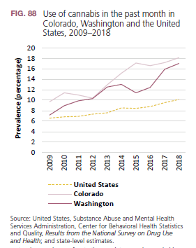
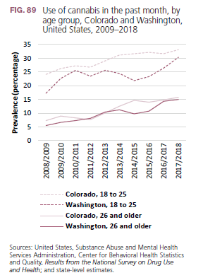
Developments in Colorado and
Washington
Colorado and Washington were the first two states in the United States to legalize the production of cannabis for non-medical use, in 2012
Extent of adult non-medical use of cannabis in Colorado and Washington

Slide 12
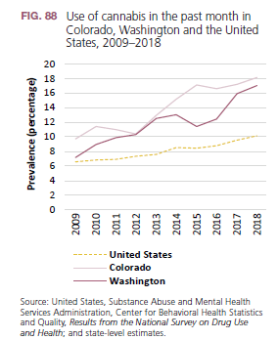
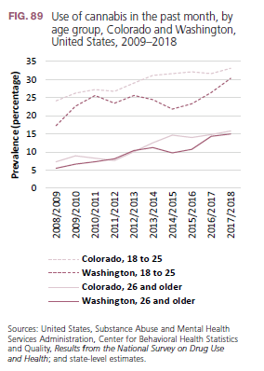
Developments in Colorado and
Washington: Extent of non-medical use of cannabis among adolescents

Slide 13
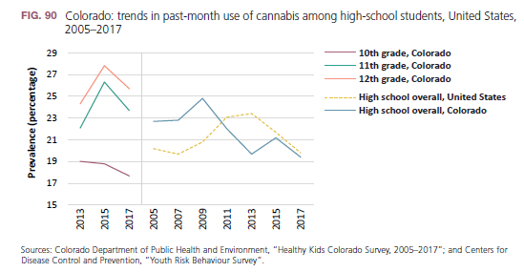
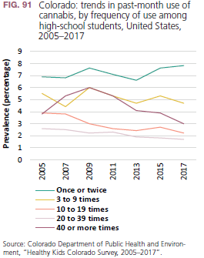
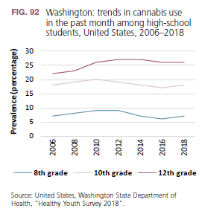
Developments in Colorado and
Washington: Extent of non-medical use of cannabis among adolescents

Slide 14
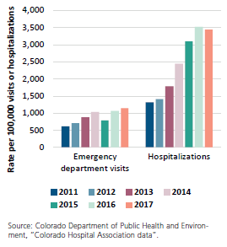
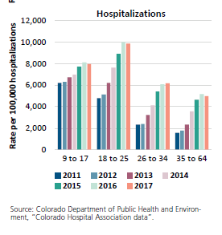
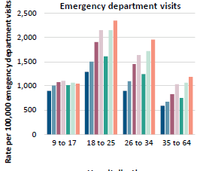
Developments in Colorado public health outcomes: emergency department visits and hospitalization
Colorado: cannabis-related emergency department visits and hospitalizations, by age group, United States, 2011–
2017
Colorado: cannabis-related emergency
department visits and hospitalizations,
United States, 2011–2017

Slide 15
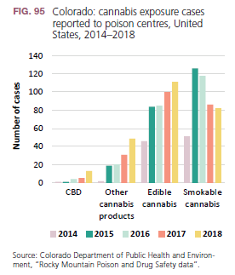
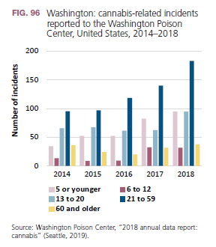
Public health outcomes: cannabis-related poisoning incidents in Colorado and Washington state

Slide 16
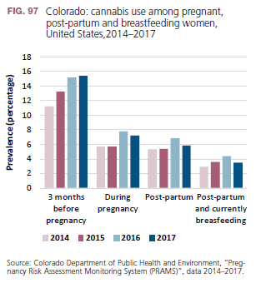
Public health outcomes: cannabis use
before and during pregnancy and in the
post-partum stage
Cannabis use
among young women may affect their menstrual cycle and their ability to become pregnant.
Also associated with low birth weight, low alertness and other neurodevelopmental effects on newborns
use by the mother in the postpartum and breastfeeding stages may impact the infant’s growth and health

Slide 17
Public health outcomes: cannabis use
before and during pregnancy and in the
post-partum stage
Cannabis use
among young women may affect their menstrual cycle and their ability to become pregnant.
Also associated with low birth weight, low alertness and other neurodevelopmental effects on newborns
use by the mother in the postpartum and breastfeeding stages may impact the infant’s growth and health

Slide 18
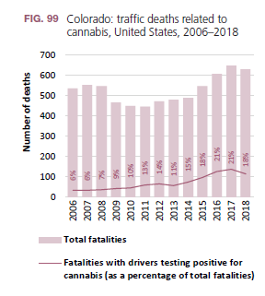
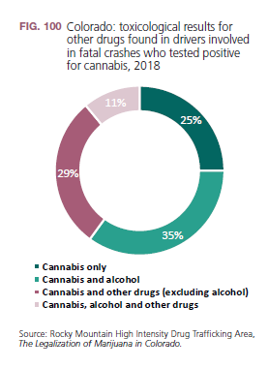
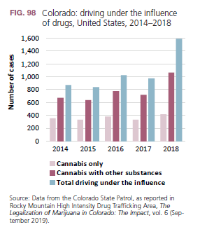
Public safety outcomes: cannabis-related driving under the influence and traffic fatalities in Colorado

Slide 19
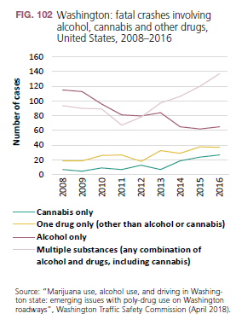
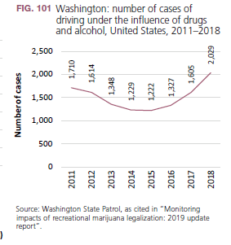
Public safety outcomes: cannabis-related driving under the influence and traffic fatalities in Colorado

Slide 20
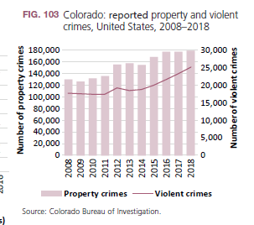
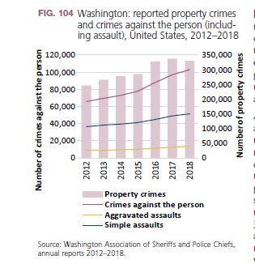
Public safety outcomes: Crime and the non-medical use of cannabis in Washington and Colorado

Slide 21
Developments in the regulation
of the non-medical use of cannabis
in Uruguay
In 2013, the Government of Uruguay approved legislation (Law No. 19.172) regulating the cultivation, production, dispensing and use of cannabis including non-medical use.
Uruguayan citizens or foreigners with permanent residence aged 18 and older can obtain cannabis for non-medical purposes by registering with the national Institute for the Regulation and Control of Cannabis and by choosing one of three options:
purchase in authorized pharmacies
membership of a club
domestic cultivation
The quantity of cannabis permitted per person, cannot exceed 480 g per year.
The Government has set limit of THC content at 2 per cent and CBD content at 6–7 per cent.

Slide 22
Developments in the regulation
of the non-medical use of cannabis
in Uruguay
Overall, the implementation of the law has been gradual; as at January 2020,
five companies had been granted licences to cultivate, produce and distribute cannabis products for non-medical use in the country.
Seventeen pharmacies had been licensed to dispense cannabis for nonmedical use, and 39,423 people had registered to acquire cannabis from those pharmacies.
By January 2020,
a total of 7,834 people had registered for domestic cultivation of cannabis, and
145 cannabis clubs with a total membership of 4,298 people had been registered.
A total of approximately 51,555 people had access to the regulated cannabis market in Uruguay at that time

Slide 23
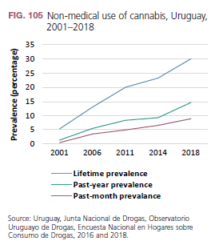
Developments in the regulation
of the non-medical use of cannabis
in Uruguay
12 per cent of men and 5.8 per cent of women had used cannabis in the past month,
since 2014, use of cannabis in the past year increased by more than 50 per cent
highest past-month prevalence of cannabis use was reported among young people aged 19–25 (20.8 per cent)
About 25,500 people were estimated to be daily or near daily users of more than one third of considered dependent

Slide 24
Developments in the regulation
of the non-medical use of cannabis
require ongoing monitoring
The regulations are implemented in different local contexts and influenced by different dynamics, which is likely to have a different impact on the development of cannabis markets
Requires monitoring of indicators relating to public health and safety and criminal justice.
It may take years of regular monitoring of different indicators to fully assess the outcome and impact of the legislation.

Slide 25
Policy discourse around non-medical use of cannabis tends to conflate issues:
The non-medical use of cannabis products containing high levels of THC (vapes and concentrates) with medical use of preparation such as dronabinol and nabiximols containing THC and CBD for treating and managing certain health conditions
chronic pain, multiple sclerosis and spasticity symptoms, as well as sleep disturbances associated with fibromyalgia and chronic pain.
Personal testimonies on the use of cannabis products to self-medicate and alleviate health conditions cannot be heeded in lieu of rigorous clinical trials on the effectiveness of cannabis products in treating certain health conditions.
CBD, a cannabinoid that is not a psychoactive agent and is often promoted as a health and wellness product, should not be confused with THC, a very different and psychoactive cannabinoid, or with cannabis per se, which contains many different compounds.

