Slide 1
WDR 2020
DRUG TRAFFICKING OVER
THE DARKNET

Slide 2
DARKNET
Long-term upward trend as vendors and customers perceive advantages – notably anonymity - in using the darknet for drug transactions; this also includes the use of cryptocurrencies such as Bitcoin.
Short-life span of darknet markets, however, continues to be a problems for users and drug sellers.
Notably the dismantling of darknet markets, market shutdowns and exit scams in recent years (AlphaBay, Hansa, RTMP in mid 2017) and WallStreet and DreamMarket in 2019) led to a temporary loss of confidence and thus temporarily falling sales figures in 2018/19.
The COVID-19 pandemic in 2020 and the subsequent lockdown in many countries, including restrictions on passenger movements by air, appear to have increased again trafficking over the darknet in 2020, notably retail trafficking of cannabis.

Slide 3
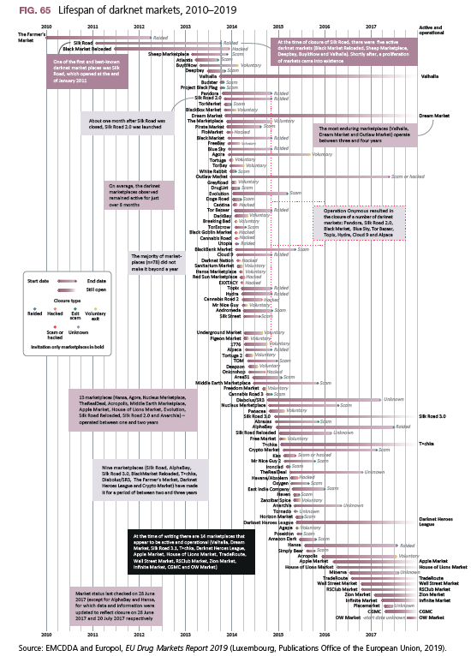
Lifespan of DARKNET markets
The typical life-span of darknet markets is rather short.

Slide 4
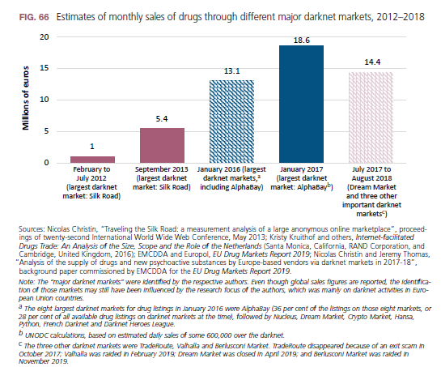
DARKNET – monthly sales
Following strong increases from 2012-2017, drug sales over the darknet ended – at least temporarily – the massive upward trend and may have even slightly declined in 2018.

Slide 5
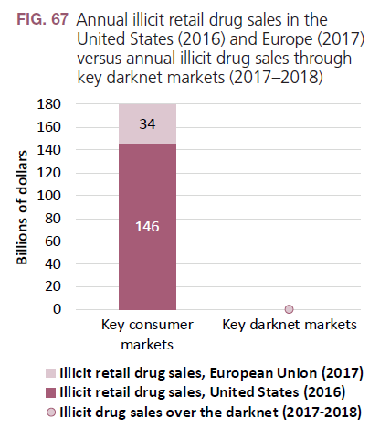
Drug supply over darknet remains modest compared to overall illicit retail drug sales
DARKNET
≈ 0.1–0.2% of US and EU drug retail sales
0.2
Sources: Gregory Midgette, Steven Davenport, Jonathan P.Caulkins and Beau Kilmer, What America’s Users Spend on Illegal Drugs, 2006–2016 (RAND Corporation, Santa Monica,
California, 2019); EMCDDA and Europol, EU Drug Markets Report 2019; EMCDDA, “Analysis of the supply of drugs and new psychoactive substances by Europe-based vendors via
darknet markets in 2017–18”.

Slide 6
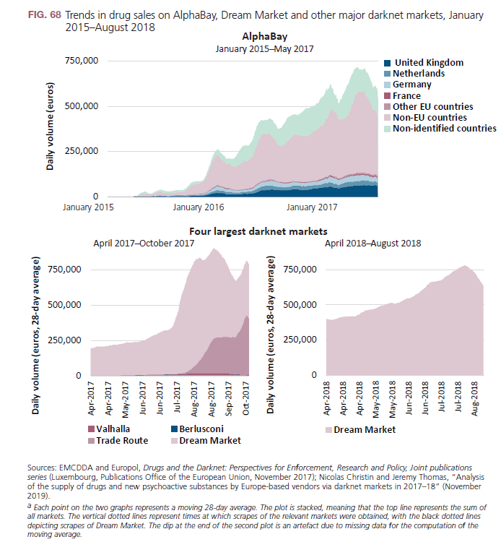
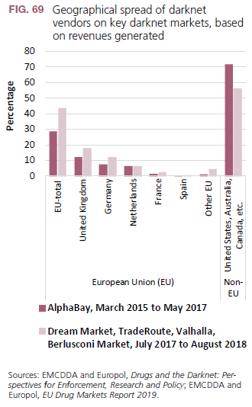
DARKNET

Slide 7
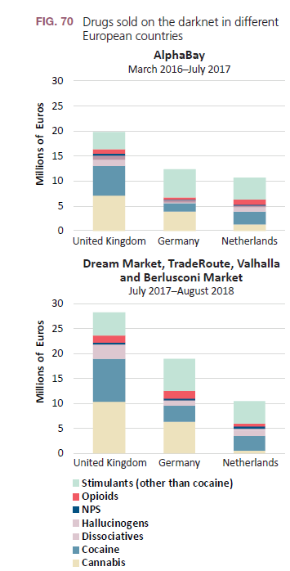
DARKNET
Despite the rapidly changing nature of the market landscape, the overall characteristics of darknet trafficking seem to have remained relatively unchanged;
the main drugs purchased over the darknet continue to be cannabis and stimulants (cocaine and ATS), followed by hallucinogens;
the three largest West-European countries selling drugs over the darknet continue to be the United Kingdom, Germany and the Netherlands.

Slide 8
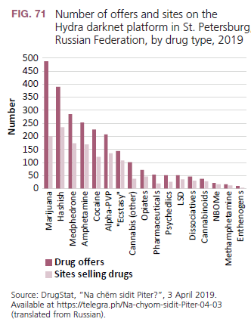
DARKNET
Despite the rapidly changing nature of the market landscape, the overall characteristics of darknet trafficking seem to have remained relatively unchanged
The Russian darknet market(s) are also dominated by cannabis though they are characterized by a stronger role played by synthetic cathinones (mephedrone and alpha-PVP).

Slide 9
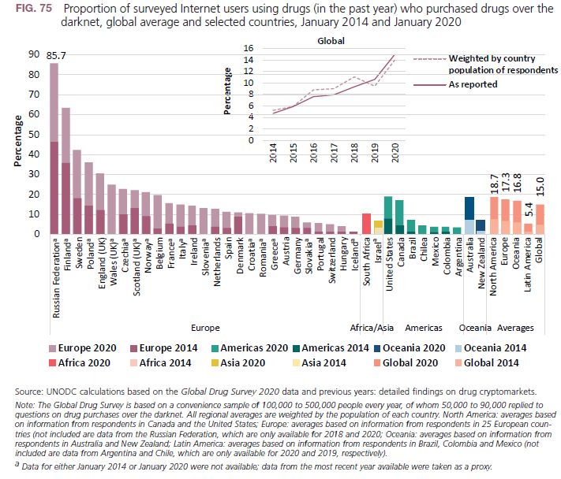
DARKNET
Long-term upward trend in most countries across all regions

Slide 10
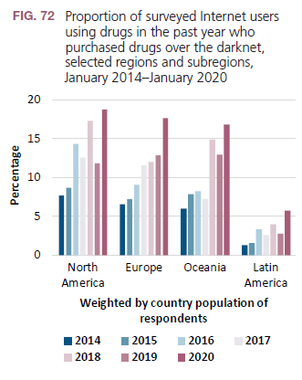
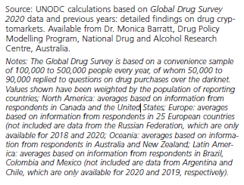
DARKNET
Long-term upward trend but temporary decline in 12 months prior to January 2019 in most regions, followed by new record high in 2020.

Slide 11
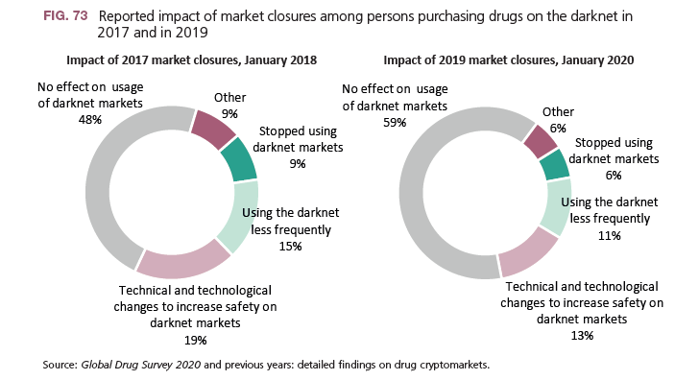
DARKNET
Impact of darknet market closures in 2017 appear to have been more significant than those in 2019.

Slide 12
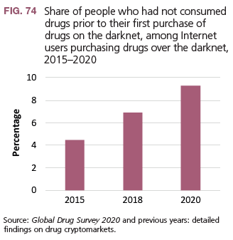
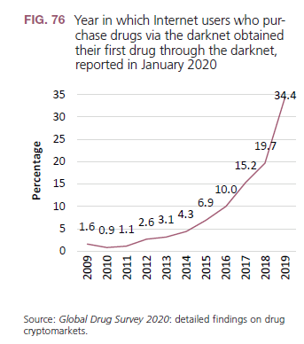
DARKNET
Proportion of people who started using drugs only after they “discovered” the darknet is on the rise.
Most users of the internet who use the darknet for purchasing drugs only recently discovered it, 34% in the last year, 69% in the last three years.

Slide 13
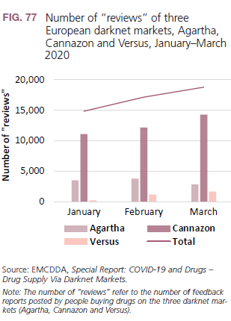
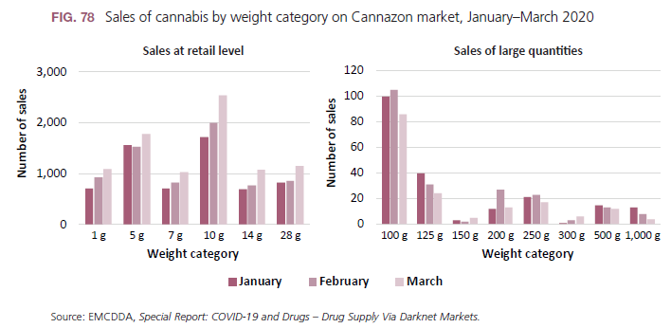
DARKNET
Drug retail sales over the darknet increased during the COVID-19 pandemic, notably cannabis retail sales, while wholesale sales over the darknet seem to have declined.

