Slide 1


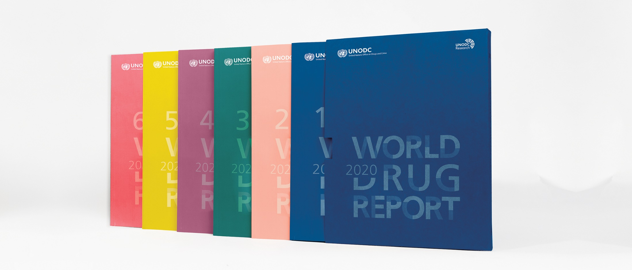
World Drug Report 2020: Opioid crisis
Vienna, 25 June 2020

Slide 2
Opioid crisis in North America and Africa: common threats and different dynamic
Ease of manufacturing, easy accessibility and low-cost production
Large-scale manufacture of tramadol and fentanyls for the illicit market started in a context of an absence of international regulations
Interchangeability (or substitution) of fentanyl and tramadol within the pharmaceutical and illicit drug markets makes it more difficult to address their misuse
Fentanyl is supply drive – tramadol is not clear drug preference is related to availability of the drug more than individual liking

Slide 3
Opioid crisis in North America: market dynamics
High rates of prescriptions for pharmaceutical opioids leading to diversion and an increase in the non-medical use
Regulations introduced to reduce diversion and non-medical use
Partial resurgence of heroin use, resulting in an increase in heroin overdose deaths from 2010
Fentanyl and analogues emerge as adulterants in heroin, stimulants and as falsified pharmaceutical opioids
Fentanly emerge as the dominant opioid in overdose deaths
Overdose deaths attributed to heroin and pharmaceutical opioids stabilize or show small decrease
Fentanly related deaths main contributor to total opioid overdose deaths

Slide 4
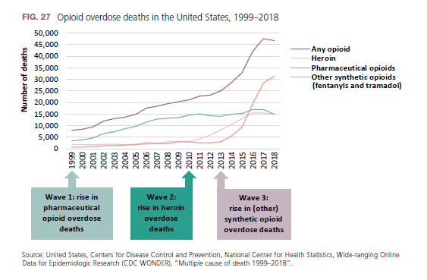
Developments in the United States: overdose deaths
Gains in the reduction of overdose deaths attributed to pharmaceutical opioids partly offset by the continuing increase in deaths attributed to synthetic opioids

Slide 5
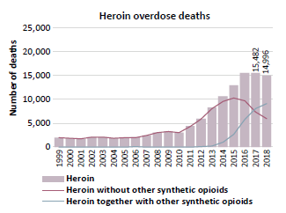
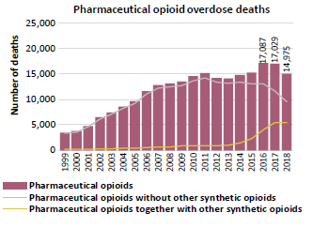
United States: reduction in overdose deaths attributed to pharmaceutical opioids and heroin (1998-2018) offset by increase in deaths involving fentanyls
Source: United States, Centers for Disease Control and Prevention, National Center for Health Statistics, Wide-ranging Online Data for Epidemiologic Research (CDC WONDER), “Multiple cause of death 1999–2018”.

Slide 6
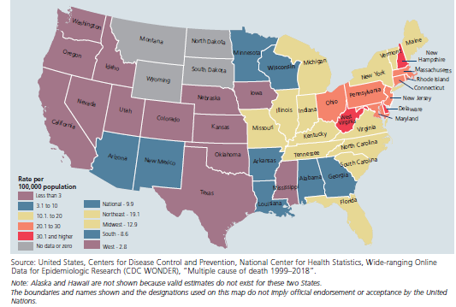
United States: Regional variations in synthetic opioid overdose deaths

Slide 7
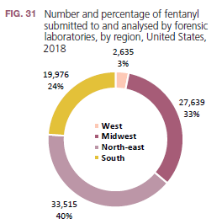
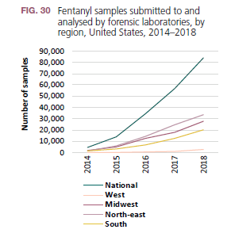
Uneven spread of fentanyl in the United States is also visible in supply indicators
Source: United States, Department of Justice, DEA, Diversion Control Division, National Forensic Laboratory Information System, reports for different years.

Slide 8
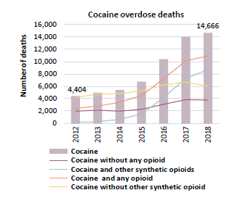
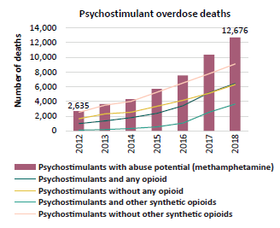
United States: fentanyls also contribute to increase in overdose deaths involving stimulants
Source: United States, Centers for Disease Control and Prevention, Wide-ranging Online Data for Epidemiologic Research, “Multiple cause of death (Detailed mortality), 1999–2018”.

Slide 9
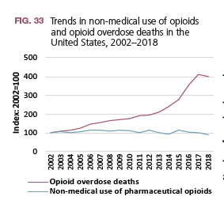
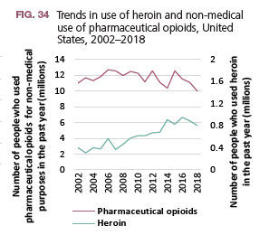
United States: Opioids use appears to be stabilizing
Sources: United States, Substance Abuse and Mental Health Services Administration, Key Substance Use and Mental Health Indicators in the United States: Results from the 2018 National Survey on Drug Use and Health (Rockville, Maryland, 2019); United States, Centers for Disease Control and Prevention, National Center on Health Statistics, “Provisional drug overdose death counts”.

Slide 10
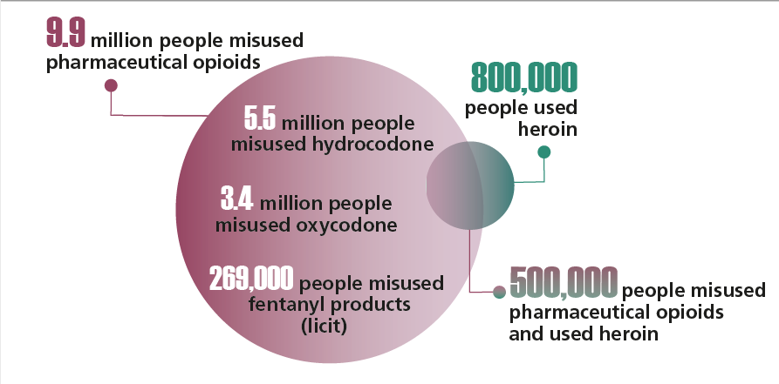
United States: overlap between past year misuse of pharmaceutical opioids and heroin, 2018
Source: United States, Substance Abuse and Mental Health Services Administration, Key Substance Use and Mental Health
Indicators in the United States: Results from the 2018 National Survey on Drug Use and Health.

Slide 11
Location
Duration
Chemicals
Source
Distribution
Sold as…
Characterization of past and current fentanyl crises in the United States
 | Prior outbreaks | Current fentanyl crisis
Location | Generally localized | Not localized, although there are regional variations
Duration | Short | Nearly six years
Chemicals | Fewer fentanyl analogues (or potent analogues such as carfentanil) | Fentanyl dominates, but there are many and more potent analogues
Source | Mostly laboratories within the United States except in one case | Almost all imported, mostly from China and Mexico
Distribution | Limited. In two outbreaks traditional illicit market actors were involved | More widespread; both traditional illicit market actors and mail order or internet
Sold as… | Often sold as heroin, and in some cases appeared in cocaine | Heroin and pharmacuetical opioids, but an increasing share of cases of cocaine and psychostimulant overdose mention synthetic opioids

Slide 12
What has driven the fentanyl crisis In US that began in 2013?
Diffusion of simpler, more effective methods of manufacture of synthetic opioids and their analogues
Availability on the Internet of instructions for their manufacture
Shift from preparation by a limited number of skilled chemists to preparation by basic “cooks”
Discovery of ever more fentanyl analogues
Lack of effective control of precursors and oversight of the industry expanding
Distribution networks that reduced the risk of detection through the use of postal services and Internet
Increased licit trade including e-commerce

Slide 13
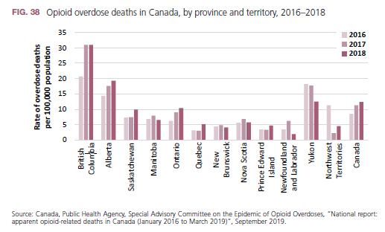
Opioid overdose deaths in Canada, 2016-2018
2 per cent reported nonmedical use of pharmaceutical opioid
opioid overdose deaths in Canada increased by 50 per cent in the past three years (4398 deaths or 11.9 deaths per 100,000 population
North-eastern states are most affected by the misuse of fentanyls and related overdose death
Source: Canada, Public Health Agency, Special Advisory Committee on the Epidemic of Opioid Overdoses, “National report: apparent opioid-related deaths in Canada (January 2016 to March 2019)”, September 2019.

Slide 14
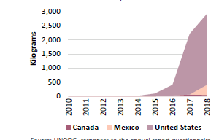
Quantitates of fentanyl seized in North America, 2010-2018
Source: UNODC, responses to the annual report questionnaire.

Slide 15
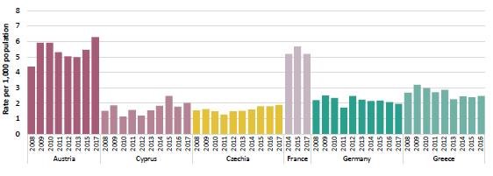
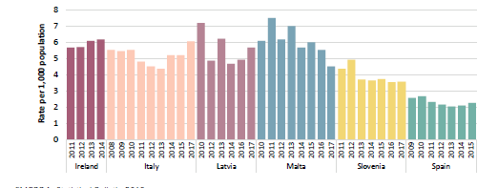
Opioids in Europe: are there indications of a fentanyl-led crisis?
Trends in high-risk opioid use in countries in Western and Central Europe

Slide 16
Opioids in Europe: are there indications of a fentanyl-led crisis?
In Western and Central Europe, there are an estimated 1.3 million high-risk opioid users127 (0.4 per cent of the population aged 15–64).
Purity of heroin is reported as relatively high and its price relatively low.
Increase in drug overdose deaths, with 8 or 9 deaths of every 10 overdose deaths in the European Union involving heroin

Slide 17
Opioids in Europe: are there
indications of a fentanyl-led crisis?
Indications that other opioids such as methadone, buprenorphine, fentanyl, codeine, morphine, tramadol and oxycodone are being increasingly misused
One of every five people entering drug treatment for an opioid-related problem in 2018 reported a synthetic opioid as their main problem drug instead of heroin.
Since 2012 more than 30 fentanyl analogues have been detected and reported.
Available on Internet, through the darknet and at street level
Sold as heroin, other illicit opioids and cocaine but also as a substitute for pharmaceutical drugs such as Xanax

Slide 18
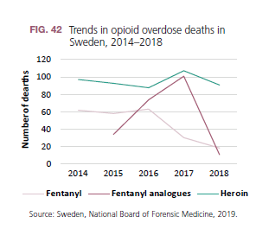
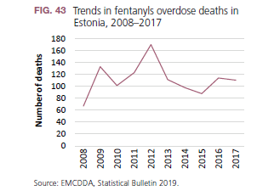
Fentanyl overdose deaths in Europe

Slide 19
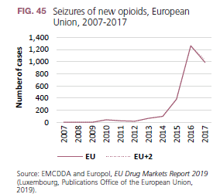
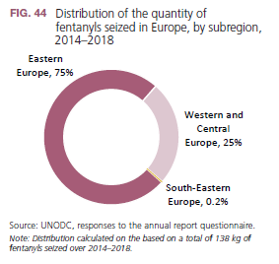
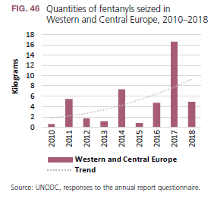
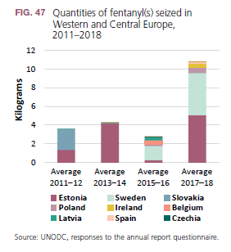
Seizures of fentanyls in EU

Slide 20
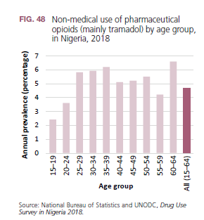
Non-medical use of tramadol:
the other opioid crisis
Non-medical use of tramadol is of particular concern among young people in many countries in Africa
In Nigeria tramadol appears to be a more accessible opioid than heroin
In Nigeria, use of tramadol appears to cost about one third the price of heroin ($3.60 versus $10 per day of use in the past 30 days)

Slide 21
Non-medical use of tramadol:
the other opioid crisis
Non-medical use of tramadol is of particular concern among young people in many countries in Africa
In North Africa, tramadol is reported as the main opioid used non-medically in Egypt.
An estimated 3 per cent of the adult population misused tramadol in 2016 while 2.2 per cent were diagnosed with tramadol dependence.
In drug treatment, tramadol was also the main drug, accounting for 68 per cent of all people treated for drug use disorders in 2017

Slide 22
Non-medical use of tramadol:
the other opioid crisis in Africa
Many young people and some categories of workers misuse tramadol to
    boost their energy,
    to be able to work long hours at physically demanding and tedious jobs, or
    for “sexual ecstasy and performance”
    perceived euphoria
    attentiveness and
    self-medication and to relieve pain.
Concerns about the non-medical use of tramadol have also arisen as there is an increasing number of people entering treatment for tramadol use disorders

Slide 23
Context of lack of access to opioid pain medication under international control in many countries where tramadol is used
In Africa, there is a chronic shortage of pain medications.
General lack of access to opioid-related pain medications under international control is a specific problem for developing countries
Against the background of de facto non-availability of internationally controlled opioids for pain medication for large sections of the population in West and Central Africa, tramadol is in fact a widely available opioid in those countries, used for both medical purposes (including outside prescription) and for non-medical purposes

Slide 24
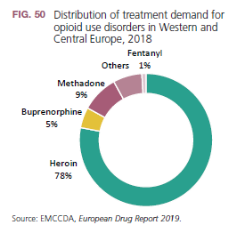
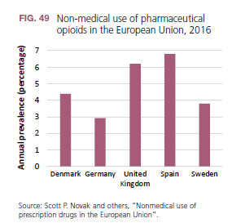
Is the non-medical use of tramadol and other pharmaceutical opioids emerging in Europe?

Slide 25
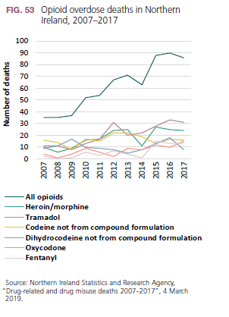
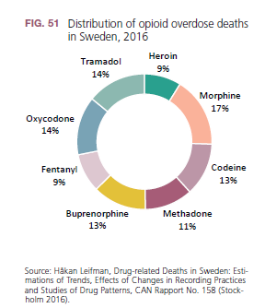
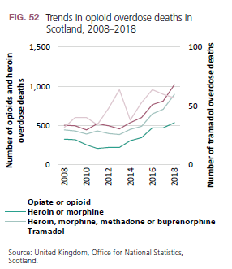
Opioid overdose deaths in Europe:
Sweden, Scotland and Northern Ireland

Slide 26
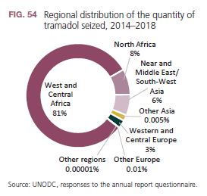
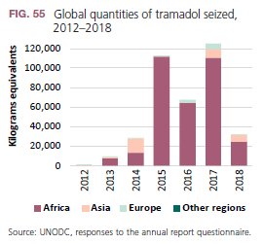
Quantities of tramadol seized globally

