Slide 1
Education for Justice (E4J)
Integrity and Ethics
Module 3: Ethics and Society

Slide 2
Agenda
Society and ethics (35 minutes)
Presentation on the importance of ethics to society (30 minutes)
Expedition to Mars exercise (90 minutes)
Plenary discussion and conclusion (25 minutes)

Slide 3
Learning outcomes
Upon completion of this module students should be able to:
Define the concept of society
Understand the relationship between ethics and society
Describe different theoretical approaches that inform this issue, with specific reference to social contract theory
Articulate and defend a preferred position on the relationship between ethics and society while appreciating its limitations

Slide 4
Society and ethics (exercise)
E1: TODAY’S NEWS

Slide 5
The importance of ethics to society
“Society … is typically marked by a conflict as well as by an identity of interest. There is an identity of interest since social cooperation makes possible a better life for all than any would have if each were to live solely by his own efforts. There is a conflict of interests since persons are not indifferent as to how the greater benefits produced by their collaboration are distributed, for in order to pursue their ends they each prefer a larger to a lesser share”.
John Rawls

Slide 6
The importance of ethics to society
“The impulse to acquisition, pursuit of gain, of money, of the greatest possible amount of money, has in itself nothing to do with capitalism …One may say that it has been common to all sorts and conditions of men at all times and in all countries of the earth, wherever the objective possibility of it is or has been given. It should be taught in the kindergarten of cultural history that this naïve idea of capitalism must be given up once and for all. Unlimited greed for gain is not in the least identical with capitalism, and is still less its spirit. Capitalism may even be identical with the restraint, or at least a rational tempering, of this irrational impulse. But capitalism is identical with the pursuit of profit, and forever renewed profit, by means of continuous, rational, capitalistic enterprise”
Max Weber

Slide 7
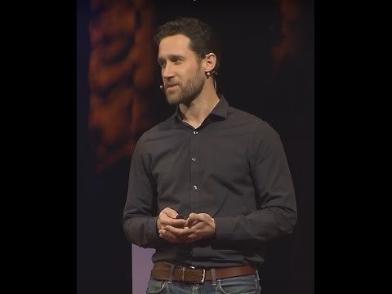
The importance of ethics to society
E2: The Everyday Ethicist
Notes:
To enable the video in a slideshow mode please follow these steps:
Click “Enable Content” in the yellow line at the top of the window (if appears).
Click with the right button of the mouse on the video and select “Preview” from the drop-down menu.
Wait few seconds until the video loads.

Slide 8
Expedition to Mars (exercise)
ROLE PLAYING:
Notes:
Explain the role of each group:
1. the builders have to build a house for each member of the colony. They will have to work 14 hours a day for the first year in order to complete all the houses (basic temporary shelter is available while construction takes place). For the final 4 years they only need to do minor maintenance and are not expected to work more than 2 hours per day. Builders will comprise 60% of the members of the colony.
2. the administrators will be responsible for law and order and the general administration of the colony. They will have sole authority to resolve all disputes and to decide on appropriate punishment in the case of transgression of rules. They will be expected to work 8 hours per day for the duration of the 5 years. Administrators will comprise 10% of the members of the colony.
3. the entertainers will be responsible for all social and educational events in the colony. They will have to arrange regular events such as plays, musical events, art classes, discussion groups, etc. The entertainers will be expected to work 4 hours per day for the duration of the 5 years, but mostly in the evenings. Entertainers will comprise 10% of the members of the colony.
4. the cientists will only be responsible for scientific research, which is the core objective of the entire project. They need to develop techniques to improve the quality of life of all members of the community, but they are also conducting highly confidential research which they are not allowed to share with anyone. Scientists can determine their own working hours and will comprise only 5% of the colony.
5. the caterers are responsible to feed the whole colony. This involves planting crops, harvesting, and preparing food. They will need to work 8 hours per day for the duration of the 5 years. Caterers will comprise 15% of the members of the colony.

Slide 9
Core reading
The Significance of Ethics and Ethics Education in Daily Life (https://www.youtube.com/watch?v=_8juebyo_Z4)
Contemporary Approaches to the Social Contract (https://plato.stanford.edu/entries/contractarianism-contemporary/)
Civil Society, United Nations (http://www.un.org/en/sections/resources-different-audiences/civil-society/index.html)

